Slide 1
Human Rights of Older People Networking Conference
28th of April 2023

Slide 2
How do we measure ‘human rights’?
where, after all, do universal human rights begin? In small places, close to home—so close and so small that they cannot be seen on any maps of the world. Yet they are the world of the individual person; the neighbourhood they live in; the school or college they attend; the factory, farm or office where they work. Such are the places where every man, woman and child seeks equal justice, equal opportunity, equal dignity without discrimination. Unless these rights have meaning there, they have little meaning anywhere. Without concerned citizen action to uphold them close to home, we shall look in vain for progress in the larger world.” (Eleanor Roosevelt)

Slide 3
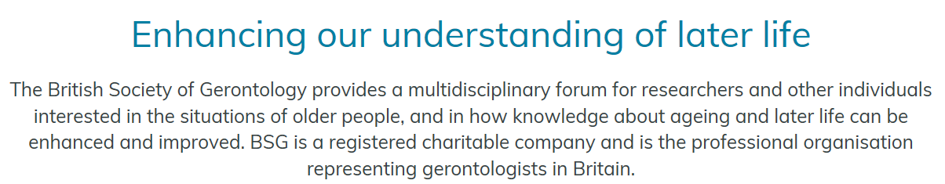

Join Today!

