Slide 1



Social care detention:
Shining a light on restrictive care practices for older adults?
Dr Lucy Series
School for Policy Studies, University of Bristol
http://thesmallplaces.blogspot.com
Image credits:
Buildings: © https://www.thetimechamber.co.uk
Artwork: @ Grace Currie, with photographs by Helter Skelter Media Ltd
Notes:
My name is Lucy series.
I am a socio-legal academic specialising in mental capacity, human rights and social care law.
That interest stems from years working in health and social care, particularly with people with learning disabilities, autism and older adults.
Academic nomad - Lecturer at Bristol School for Policy Studies, teaching law to social work students, but have also worked in law school teaching medical law, focused on mental capacity and social care law.
This talk based on my book, info at the end.
Also to say please feel free to eat lunch, use the chat for comments and questions and I’ll try and pick up on them at the end – or perhaps Emma can keep track.

Slide 2
Social care detention
A regulatory framing – safeguards for individual liberty – imposed over an underlying material reality of ‘institutional’, restrictive, supervisory and sometimes coercive practices in post-carceral community care settings.
Notes:
What is this strange new phenomenon we are talking about – social care detention.
In plain language, social care detention means regulating care arrangements in the community as a form of detention, and it is a relatively new phenomenon, but it is something that is occurring around the world as lots of countries get to grips with the sometimes quite restrictive realities of community care.
It is very different from mental health detention in lots of important ways.
But as I want to show in this talk, it is not actually something as strange and new as we might sometimes think, it actually has very deep historical roots.

Slide 3
Distinguishing social care detention
 | Social care detention | Mental health detention
Locus | ‘The community’ | Mainly hospitals
Regulatory form | Close links to ‘capacity’ and ‘guardianship’ law | Mental health law
Target populations | Long-term cognitive impairments, e.g. intellectual disabilities, dementia, autism. Particularly affects older people. | ‘Mental illness’, e.g. psychosis, affective disorders, etc. More likely to affect working age adults.
Rationalities | Protecting ‘vulnerable’ people, ‘empowerment’… | Treatment of ‘mental disorder’ and management of ‘risk’
Temporality | Months, years, lifetimes. End of life. | Weeks, months, rarely years.
Conceptual underpinnings | Mental capacity and best interests, (necessity and proportionality) | Mental disorder and risk
Lead professionals | Social workers | Psychiatry

Slide 4
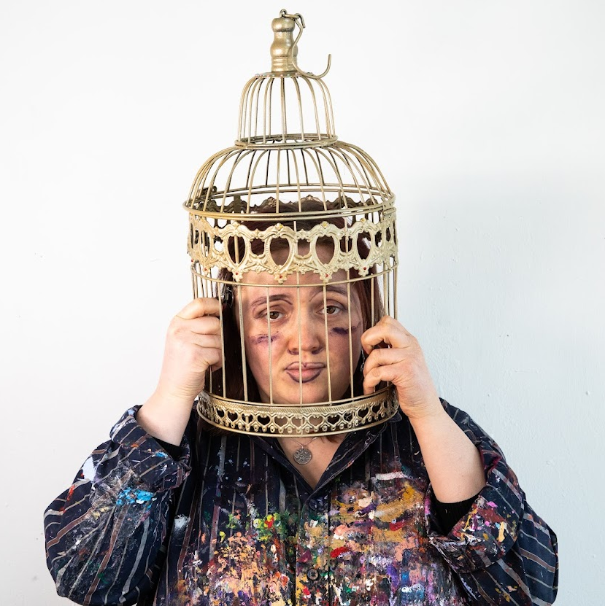
The Cheshire West ‘acid test’
In 2014 the UK Supreme Court defined a person as ‘deprived of their liberty’ if:
  They lacked the ‘mental capacity’ to consent to their care arrangements
  They were subject to ‘continuous supervision and control’ and ‘not free to leave’
  In the ruling the justices held that a person’s happiness, the nature of their disability and care needs, and whether they lived in a ‘domestic home’ or an institution were irrelevant to the ‘objective’ question of whether or not they were deprived of their liberty.
P v Cheshire West and Chester Council and another; P and Q v Surrey County Council [2014] UKSC 19
‘A gilded cage is still a cage… in the end it is the constraints that matter’
Lady Hale

Slide 5
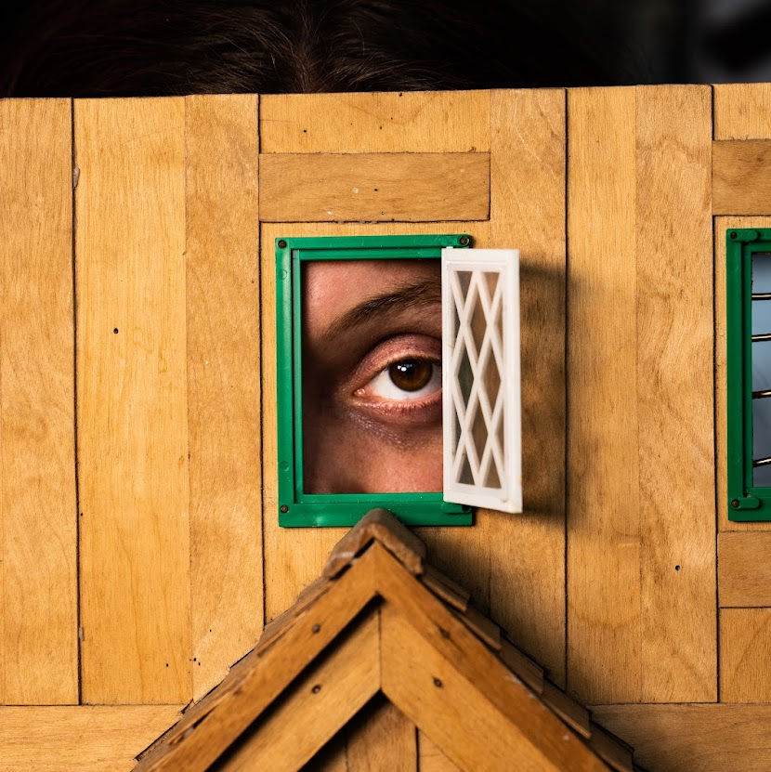
On detaining 300,000 people…
There are more people deprived of their liberty in Britain’s care homes than its prisons (178,927 applications to deprive people of their liberty in residential care in England and Wales in 2021-22)
Estimated 53,000 ‘domestic deprivation of liberty’ (e.g. supported accommodation, ‘private’ domestic settings, family based care)
‘Safeguards’ provided under the Mental Capacity Act 2005 (Deprivation of liberty safeguards, to be replaced by Liberty Protection Safeguards in due course)
Significant age skew: 84% of DoLS applications related to adults over 65; 42% are over 85
19% of DOLS applications ‘not granted’ because the person died before it was processed.

Slide 6

Like a shard of glass…
“She’s been deprived of her liberty since 27 February 2020.” it felt as though a shard of glass was piercing my soul.
“Deprived of her liberty” is a common legal term that I have heard many times over the past few months and to some extent I have become used to it. But occasionally, like this time, it hits me emotionally. Because it is a term used to refer to my mother’s situation.
And whereas the law regards her as being deprived of her liberty, we, her family, believe that she is a vulnerable adult who is somewhere safe, protected and well cared for.
‘Deprived of her liberty’: My experience of the court procedure for my mum
(Court of Protection Open Justice Project, 2023)

Slide 7

Counter-intuitive?
‘nobody using ordinary language’ would describe ‘people living happily in a domestic setting’ as deprived of their liberty’
Lords Carnwath, Hodge and Clarke , dissenting justices in Cheshire West
‘to characterise those measures as state detention is to my mind unreal. I referred to the historical context in which Article 5 of the ECHR 1950 came to be formulated. .. It was aimed at the midnight knock on the door; the sudden disappearance; the prolonged detention. Article 5 was not aimed at Katherine, seriously physically and mentally disabled, who is living in her own home and cared for round the clock by carers paid for by an organ of the state.’
Mostyn J in The London Borough of Tower Hamlets v TB & Anor [2014] EWCOP 53

Slide 8






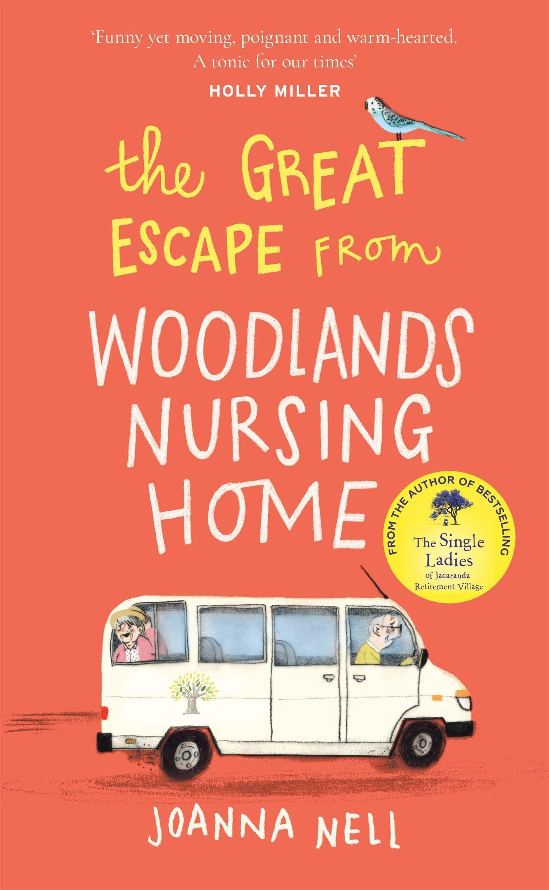

Yet… also intuitive?
Notes:
What do these books/films have in common?
They all feature a person– older or disabled – who is in some way confined (or going to be confined) to a care home, and they often escape.
That is to say, they are all about confinement in care homes, or – as I will refer to it in this talk they are all about social care detention.
I’m showing you this because I think that we often think of social care detention as something new, something perhaps invented by the deprivation of liberty safeguards in 2009, some creature of law.
And sometimes we argue that the law is mistaken, that care homes aren’t places of detention.
Yet another way to look at this is to say that the law has only just caught up with what our popular culture was telling us all along: care homes can be sites of confinement that many older and disabled people experience and that many of us dread.

Slide 9

Mr P
Mr P (91), a retired civil servant and RAF gunner in WW2, lived alone with Fluffy, his cat, in his home of 50 years. He had dementia and health problems.
Following concerns raised by his friends, a ‘safeguarding’ decision was taken to move him into a locked dementia care home.
A social worker removed him at night, dressed only in his dressing gown, telling him the police would be called if he did not comply.
Eventually, the care home sought a DoLS authorization as Mr P continued to say he wanted to go home.
He was found to have mental capacity. The case went to court, the judge ordered his return home, and awarded damages for human rights violations.
His friends later told the judge he was happy living at home with Fluffy the cat and his new carers.
Essex County Council v RF & Ors (Deprivation of Liberty and damage) [2015] EWCOP 1

Slide 10
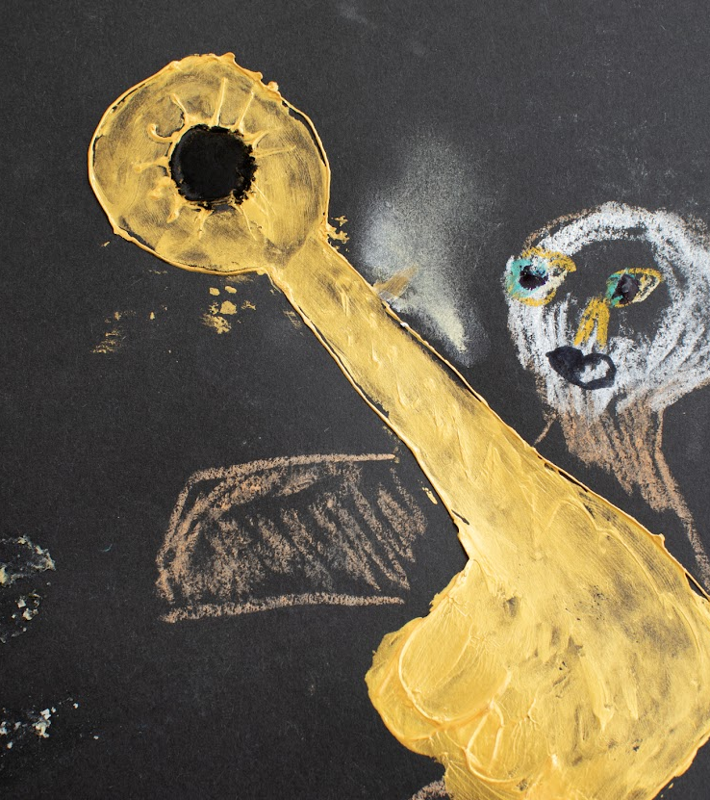
Why recognize and regulate social care detention?
Calling it out: Many older adults are subject to restrictive practices in care settings, including physical, mechanical, chemical restraint and confinement. This has worsened during the pandemic.
Abolitionist: For activists, labelling these practices a ‘deprivation of liberty’ can bolster claims to abolish restrictive care practices wherever they take place, particularly in connection with the CRPD.
Reformist: For reformers, liberty ‘safeguards’ are attractive as a way to reduce (but not abolish) restrictive practices and ‘shine a light’ on the circumstances of care, enabling challenge and improvement where possible.

Slide 11

Limits and challenges
Calling it out: Labelling something a ‘deprivation of liberty’ does not necessarily result in reduction, it can (paradoxically) result in it being legitimated through authorization and normalization processes.
Abolitionist: There are some situations where it is extremely hard to see how to avoid some level of ‘supervision and control’. Even if we strengthen ‘legal capacity’ provisions to facilitate consent, there will be people who continue to object to their arrangements.
Reformist: Liberty safeguards only operate among the ‘actually existing options’ – if there are no less restrictive options available, it is very hard to secure improvements. They need to be coupled to strong positive obligations to deliver meaningful entitlements to home, personal assistance, and non-coercive support (i.e. ‘independent living’…)

Slide 12
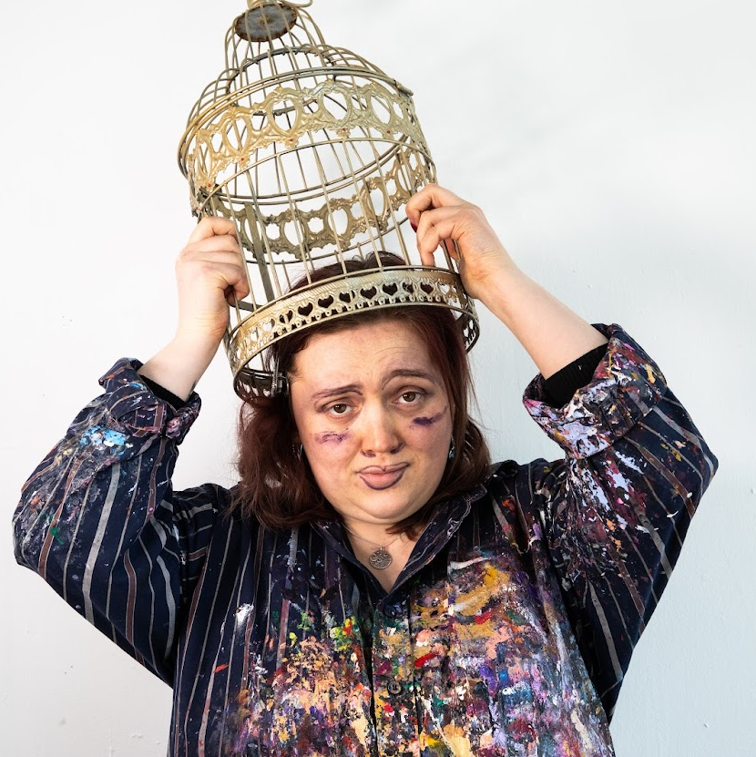
Take home messages
Regulating restrictive community care arrangements as social care detention recognizes the realities of care for many older (and disabled) adults
However, recognition and even regulation does not solve the problem (and potentially legitimates it)
For abolitionists and reformers alike, there also need to be strong positive obligations to deliver less restrictive (non-institutional) alternatives to mainstream care for older adults, modelled on article 19 CRPD.
Abolitionists need to think deeply about what ‘liberty’ looks like for people whose care may require a level of supervision and control (or be honest about the realities of this model)

Slide 13
Credits, copyright and grateful thanks…
Funding for research and open access book: Wellcome Society and Ethics Research Fellowship (2017-2022)
Photographs of derelict asylums: © Time Chamber
Artworks: © Grace Currie (artist) (photographs © Helter Skelter Ltd)
Deprivation of Liberty in the Shadows of the Institution (BUP 2022) – open access
https://bristoluniversitypress.co.uk/deprivation-of-liberty-in-the-shadows-of-the-institution
Watch the movie:
https://gracecurrie.art/project/in-the-shadow-of-the-institution
Further (open access) articles on this topic: https://research-information.bris.ac.uk/en/persons/lucy-series

