Slide 1

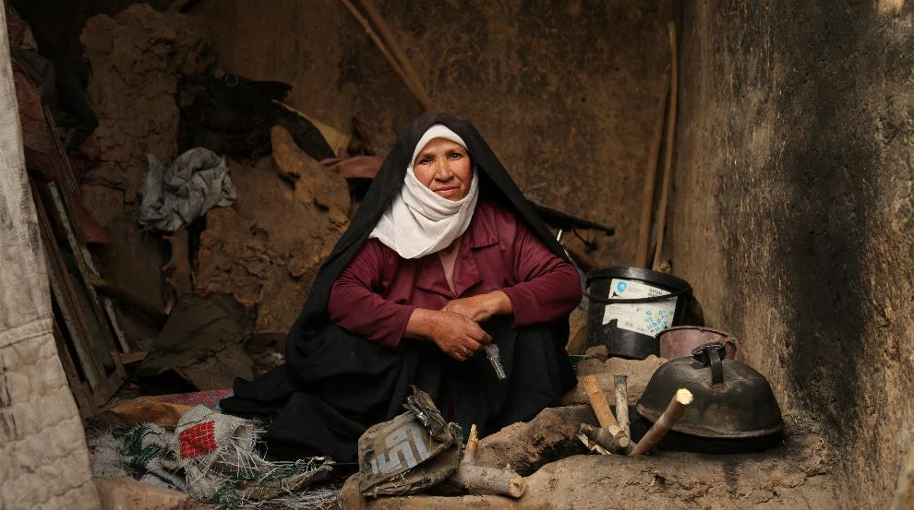
Towards a UN Convention on the Rights of Older Persons
We work for the rights of older people in low and middle income countries: development and humanitarian.
Top priority for Age International.

Slide 2

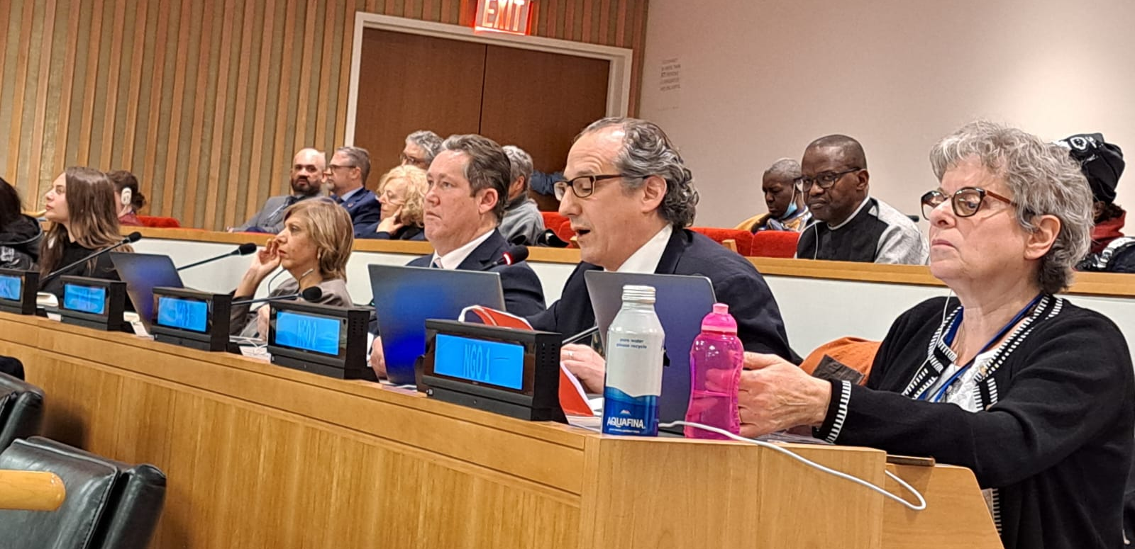
Championing a Convention
Journey since 2010 - first meeting of UN OEWG 2011.
Creation of Independent Expert.
Pressure through Human Rights Council in Geneva and review of the Madrid International Plan of Action on Ageing.
Steady increase in Member States supporting a Convention.
NGO Committee on Ageing.
Global Alliance for the Rights of Older People (GAROP) - over 400 members.
3-6 April 2023 in New York
13th session of “Open Ended Working Group on Ageing for the purpose of strengthening the protection of the human rights of older persons”

Slide 3
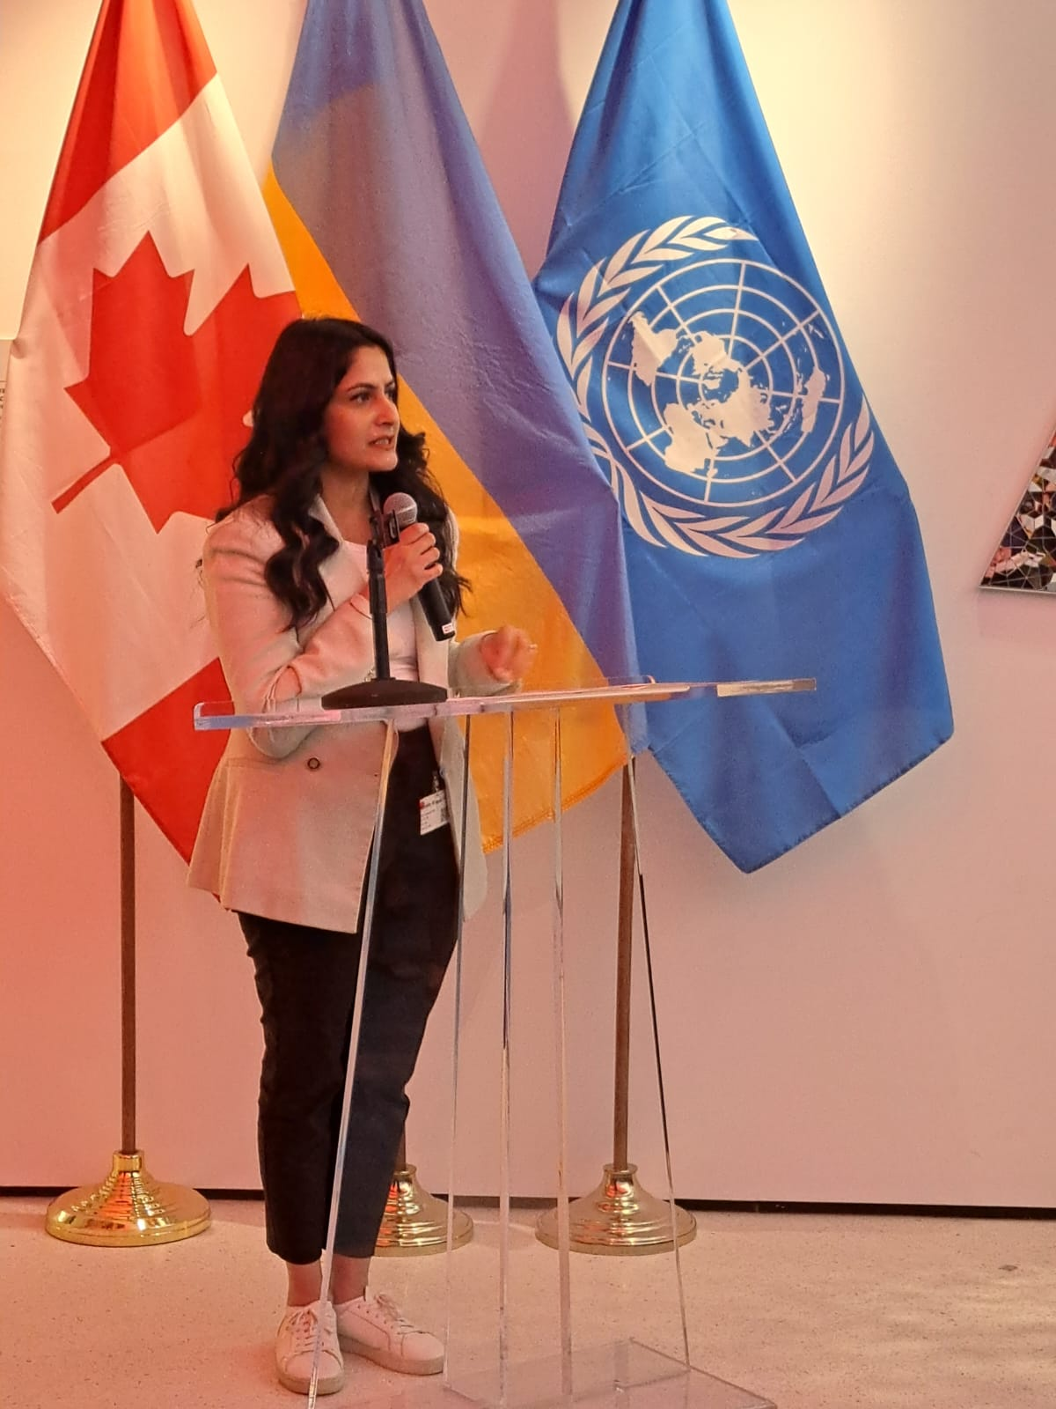
Championing a Convention
Participation: ‘nothing about us without us’
Process: precise and persistent
Political: people power!

Slide 4
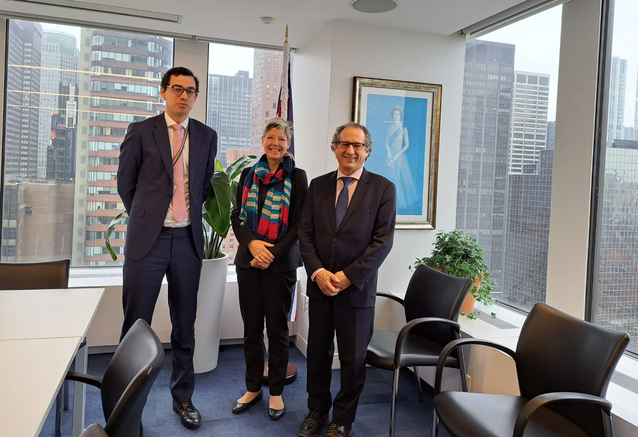
UK Government
Open to a Convention: constructive in OEWG and HRC
“We are supportive in principle for a multilateral instrument dedicated to the human rights of older people.”
But not priority, nor proactive.
Opportunity with both main political parties in run up to General Election: make a Convention attractive.

Slide 5
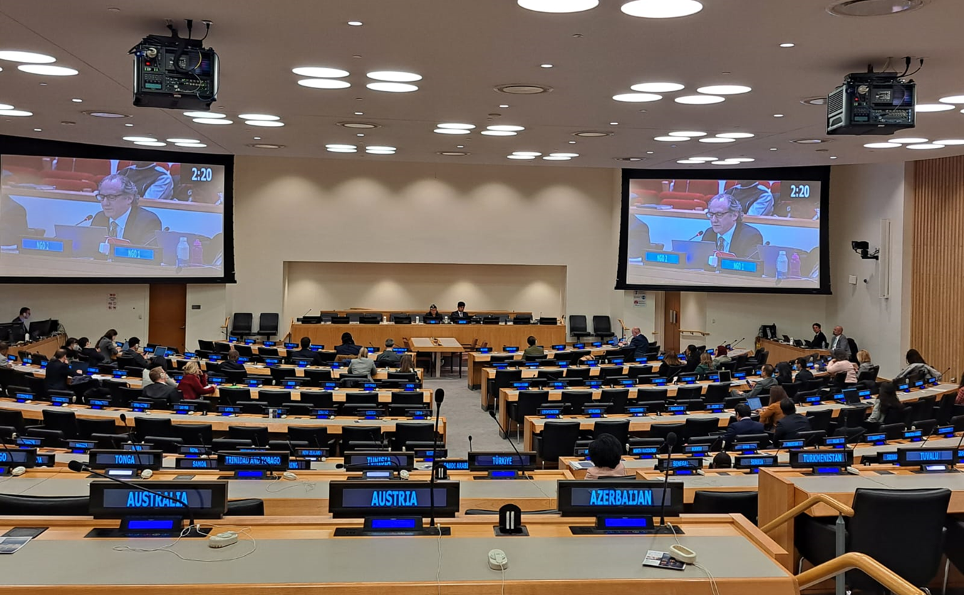
Next steps: Governments agreed to hold discussions between now and April 2024, moving a step towards drafting a new UN Convention

Slide 6
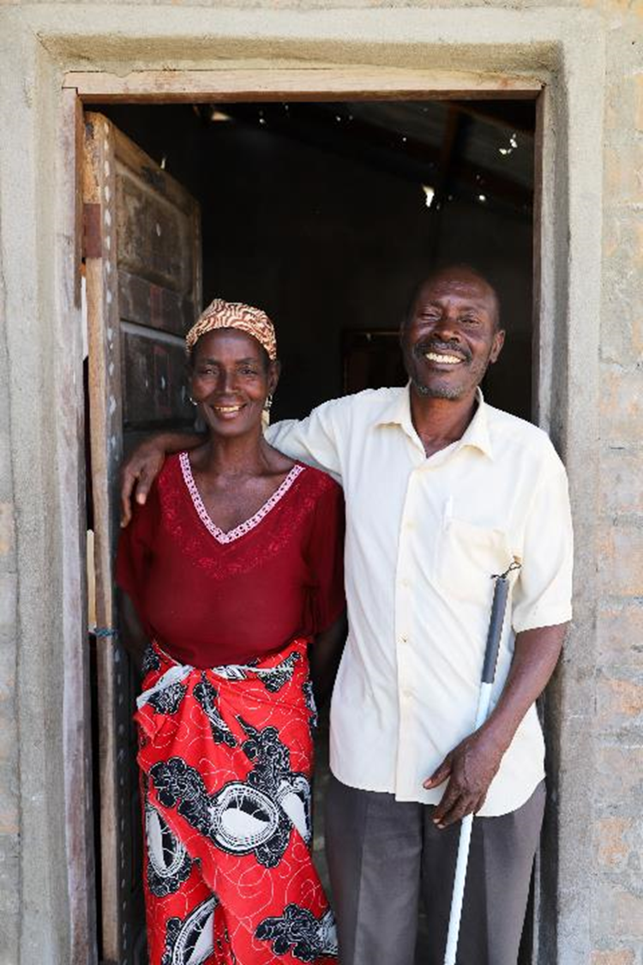
Call to action!
1/. Join GAROP!
2/. Apply for accreditation to the OEWG so your organisation can make written inputs.
3/. Write to your MP and the FCDO asking them to support a Convention
Together we can galvanise leadership from the UK government!

