Slide 1

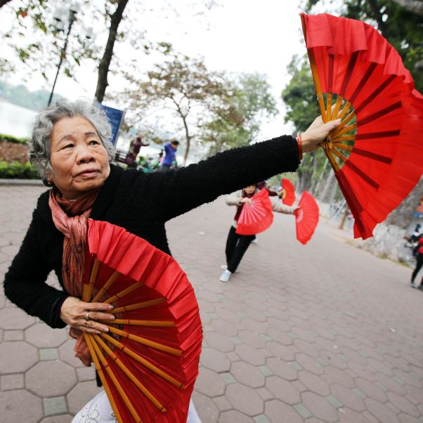
UN- Independent Expert on the Enjoyment of all Human Rights by Older Persons – how to strenghen the human rights of older persons!
Independent Expert on the enjoyment of all human rights by older persons
Human Rights of Older People Networking Conference 28.04.2023

Slide 2
Mandate of the Independent Expert
Mandated by the Human Rights Council Resolution 24/20 to assess the implementation of existing international human rights instrument relevant for older persons
Identify and adress the promotion of those rights
As well as the gaps and challenges in their realization

Slide 3
Tasks
Two country missions per year
Two thematic reports each year
  - one report to the Human Rights Council – in Geneva
  - one report to the General Assembly – 3rd Committee – in New York
Communication
Comments on legislation and policy

Slide 4
Thematic reports - Annual reports | OHCHR
A/75/205: Impact of the coronavirus disease (COVID-19) on the enjoyment of all human rights by older persons
A/HRC/48/53: Report on ageism and age discrimination
A/76/157: Human rights of older women: the intersection between ageing and gender
A/51/27: Report on older persons deprived of their liberty
A/77/239: Older persons and the right to adequate housing - Note by the Secretary-General
Next reports:
  – violence, abuse and neglect of older persons
  – older persons in the context of climate change-induced disasters and building back better

Slide 5
Why do we need to strenghen the Human Rights of older persons?
Number of older persons will double between 2019 to 2050 globally
Older persons are still not visible in the human rights framework
No specific global human rights instrument on the rights of older persons
Gaps in the current human rights framework - G2223886.pdf (un.org)
UN convention on the rights of older persons will give guidance as other UN Conventions – eg. UN-CRPD

Slide 6
UN Open-ended Working Group on Ageing- https://social.un.org/ageing-working-group/
First session in 2011 – state driven process / General Assembly / NY
Chair: Argentina
Bureau : Canada, Philippines, Nigeria, Slovakia
Secretariat: UN-DESA, OHCHR
12th session in 2022 – cross regional core-group
13th session in 2023 – decision to have two co-facilitators to identify existing gaps and find solutions – working in the intersessional period
– best solution with the best protection and a lot of added values - a dedicated human rights convention for older persons

Slide 7
Time for action:
Support the work of IE – call for contribution – to thematic reports or in advance of country mission, communication and allegation procedure!
Spread the word of the OEWG-A on the national level and join the session
Inform other key stake holders – collaborate with different groups – intersecting factors should be made visible
Ask your government how they see the process and their position on drafting a convention on the rights of older persons
Use UN Days to raise awareness to the human rights of older person

Slide 8


Slide 9
Contact Information
Ms. Claudia Mahler
Independent Expert on the enjoyment of all human rights by older persons
OHCHR-UNOG CH-1211 Geneva 10, Switzerland
Fax: +41 22 917 9006
E-mail: hrc-ie-olderpersons@un.org
Twitter: @IE_OlderPersons

