Slide 1
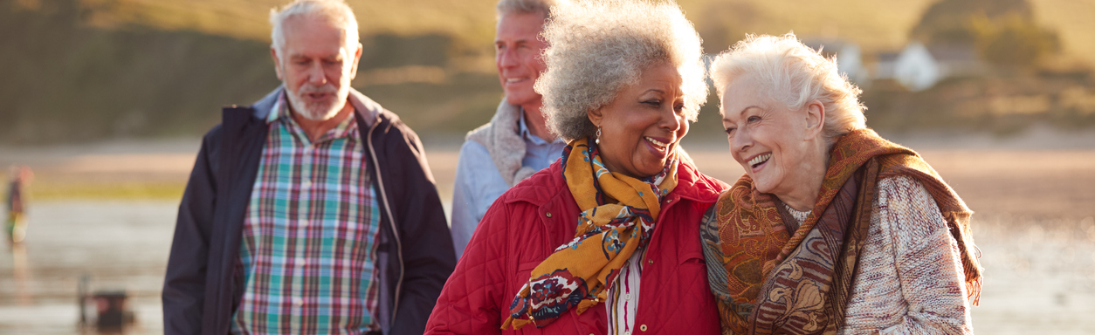





Heléna Herklots CBE
Comisiynydd Pobl Hŷn Cymru
Older People's Commissioner for Wales
@comisiwnphcymru @talkolderpeople @HelenaHerklots
https://comisiynyddph.cymru
https://olderpeople.wales
Comisiynydd Pobl Hŷn Cymru
Older People's Commissioner for Wales

Slide 2
Commissioner’s Functions
Promote awareness of the interests of older people in Wales and of the need to safeguard those interests;
Promote the provision of opportunities for, and the elimination of discrimination against, older people in Wales;
Encourage best practice in the treatment of older people in Wales;
Keep under review the adequacy and effectiveness of law affecting the interests of older people in Wales.

Slide 3
Commissioner’s Legal Powers
Review of the discharge of functions of public bodies
Review of advocacy, whistle-blowing or complaints arrangements
Assisting an older person in making a complaint or representing to a public body
Examining the case of an older person in a matter that affects the interest of a wider group of older people
Issuing guidance on best practice to public bodies

Slide 4




Commissioner’s Priorities
Protecting and Promoting Older People’s Rights
Stopping the Abuse of Older People
Ending Ageism and Age Discrimination
Enabling Everyone to Age Well

Slide 5
Older people’s rights since 2020
Awareness and understanding of rights is low
Context of ageism – stereotypes and perceptions of older people
Removal of rights
Undermining of rights – do rights matter?
Making rights real
Shared experiences; shared endeavour

Slide 6


Rights of Older People Living in Care Homes

Slide 7
The Rights of Older People Living in Care Homes – Action Group
Key areas of work:
Raising awareness of the rights of older people living in care homes
Producing information about Human Rights and legal rights
Promoting dignity, respect, and the upholding of rights
Working with service and workforce regulators to embed Human Rights in inspection frameworks and within social care practice
Increasing residents’ security of tenure
Increasing care home residents’ access to independent advocacy, in particular for those residents without family or friends

Slide 8
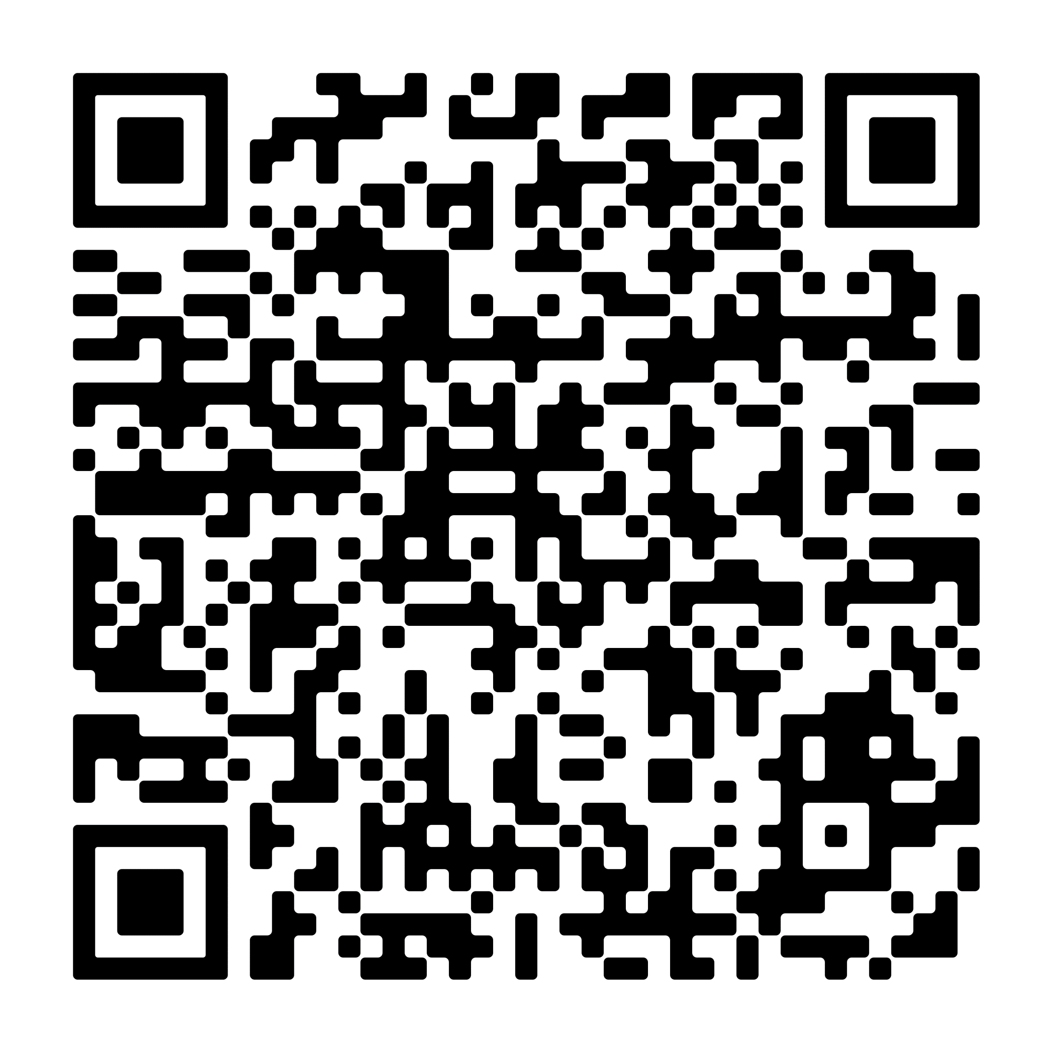


The Rights of Older People Living in Care Homes – Action Group
Download from: https://olderpeople.wales/your-rights/

Slide 9


Digital inclusion

Slide 10
A Human Rights Act for Wales?
Welsh Government committed to strengthening and advancing human rights in Wales
An Age-friendly Wales: Strategy for an Ageing Society - Oct. 2021
  Adopts a rights-based approach
  An age friendly Wales that upholds older people’s rights
  Rejects ageism in all its forms
Exploring legislative options for a Welsh human rights framework
  WG commitment to incorporate CEDAW and CRPD*
  Considering incorporation of other UN instruments and bespoke rights
  Protect against external threats to undermine human rights
  *CEDAW Convention on the Elimination of Discrimination against Women
  *CRPDConvention on the Rights of Persons with Disabilities

Slide 11


Working for a Wales where older people are valued, rights are upheld and no-one is left behind.

Slide 12
Diolch
Thank you
@comisiwnphcymru @talkolderpeople
https://comisiynyddph.cymru
https://olderpeople.wales
Comisiynydd Pobl Hŷn Cymru
Older People's Commissioner for Wales

