Slide 1
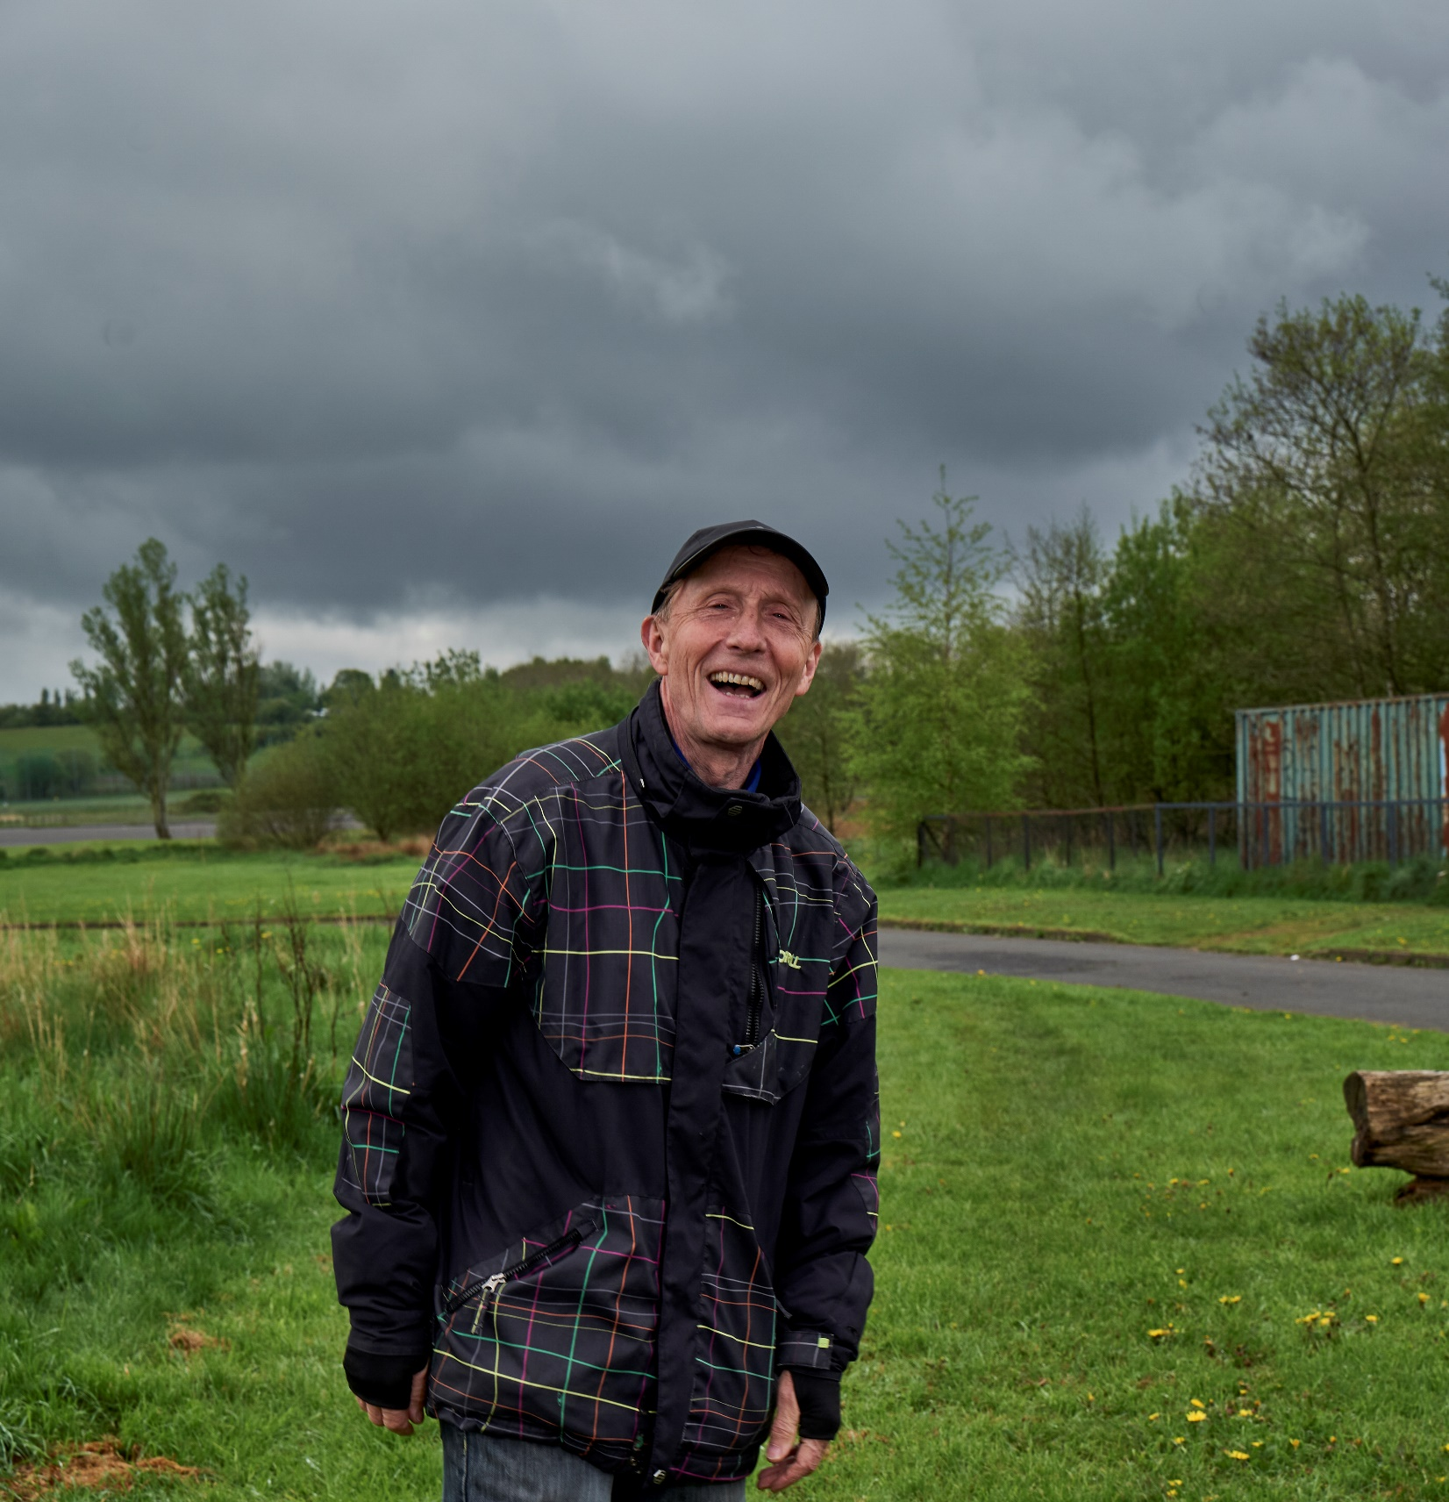
Tackling Ageism
Notes:
Thank you - talk t you tuday about role of business in challenging ageism

Slide 2
Ageing Better
About our work
Challenging Ageism
  What is Ageism?
  Intersectionality and Ageism
  Our forthcoming campaign
  our call for a Commissioner for Older People and Ageing in England

Slide 3
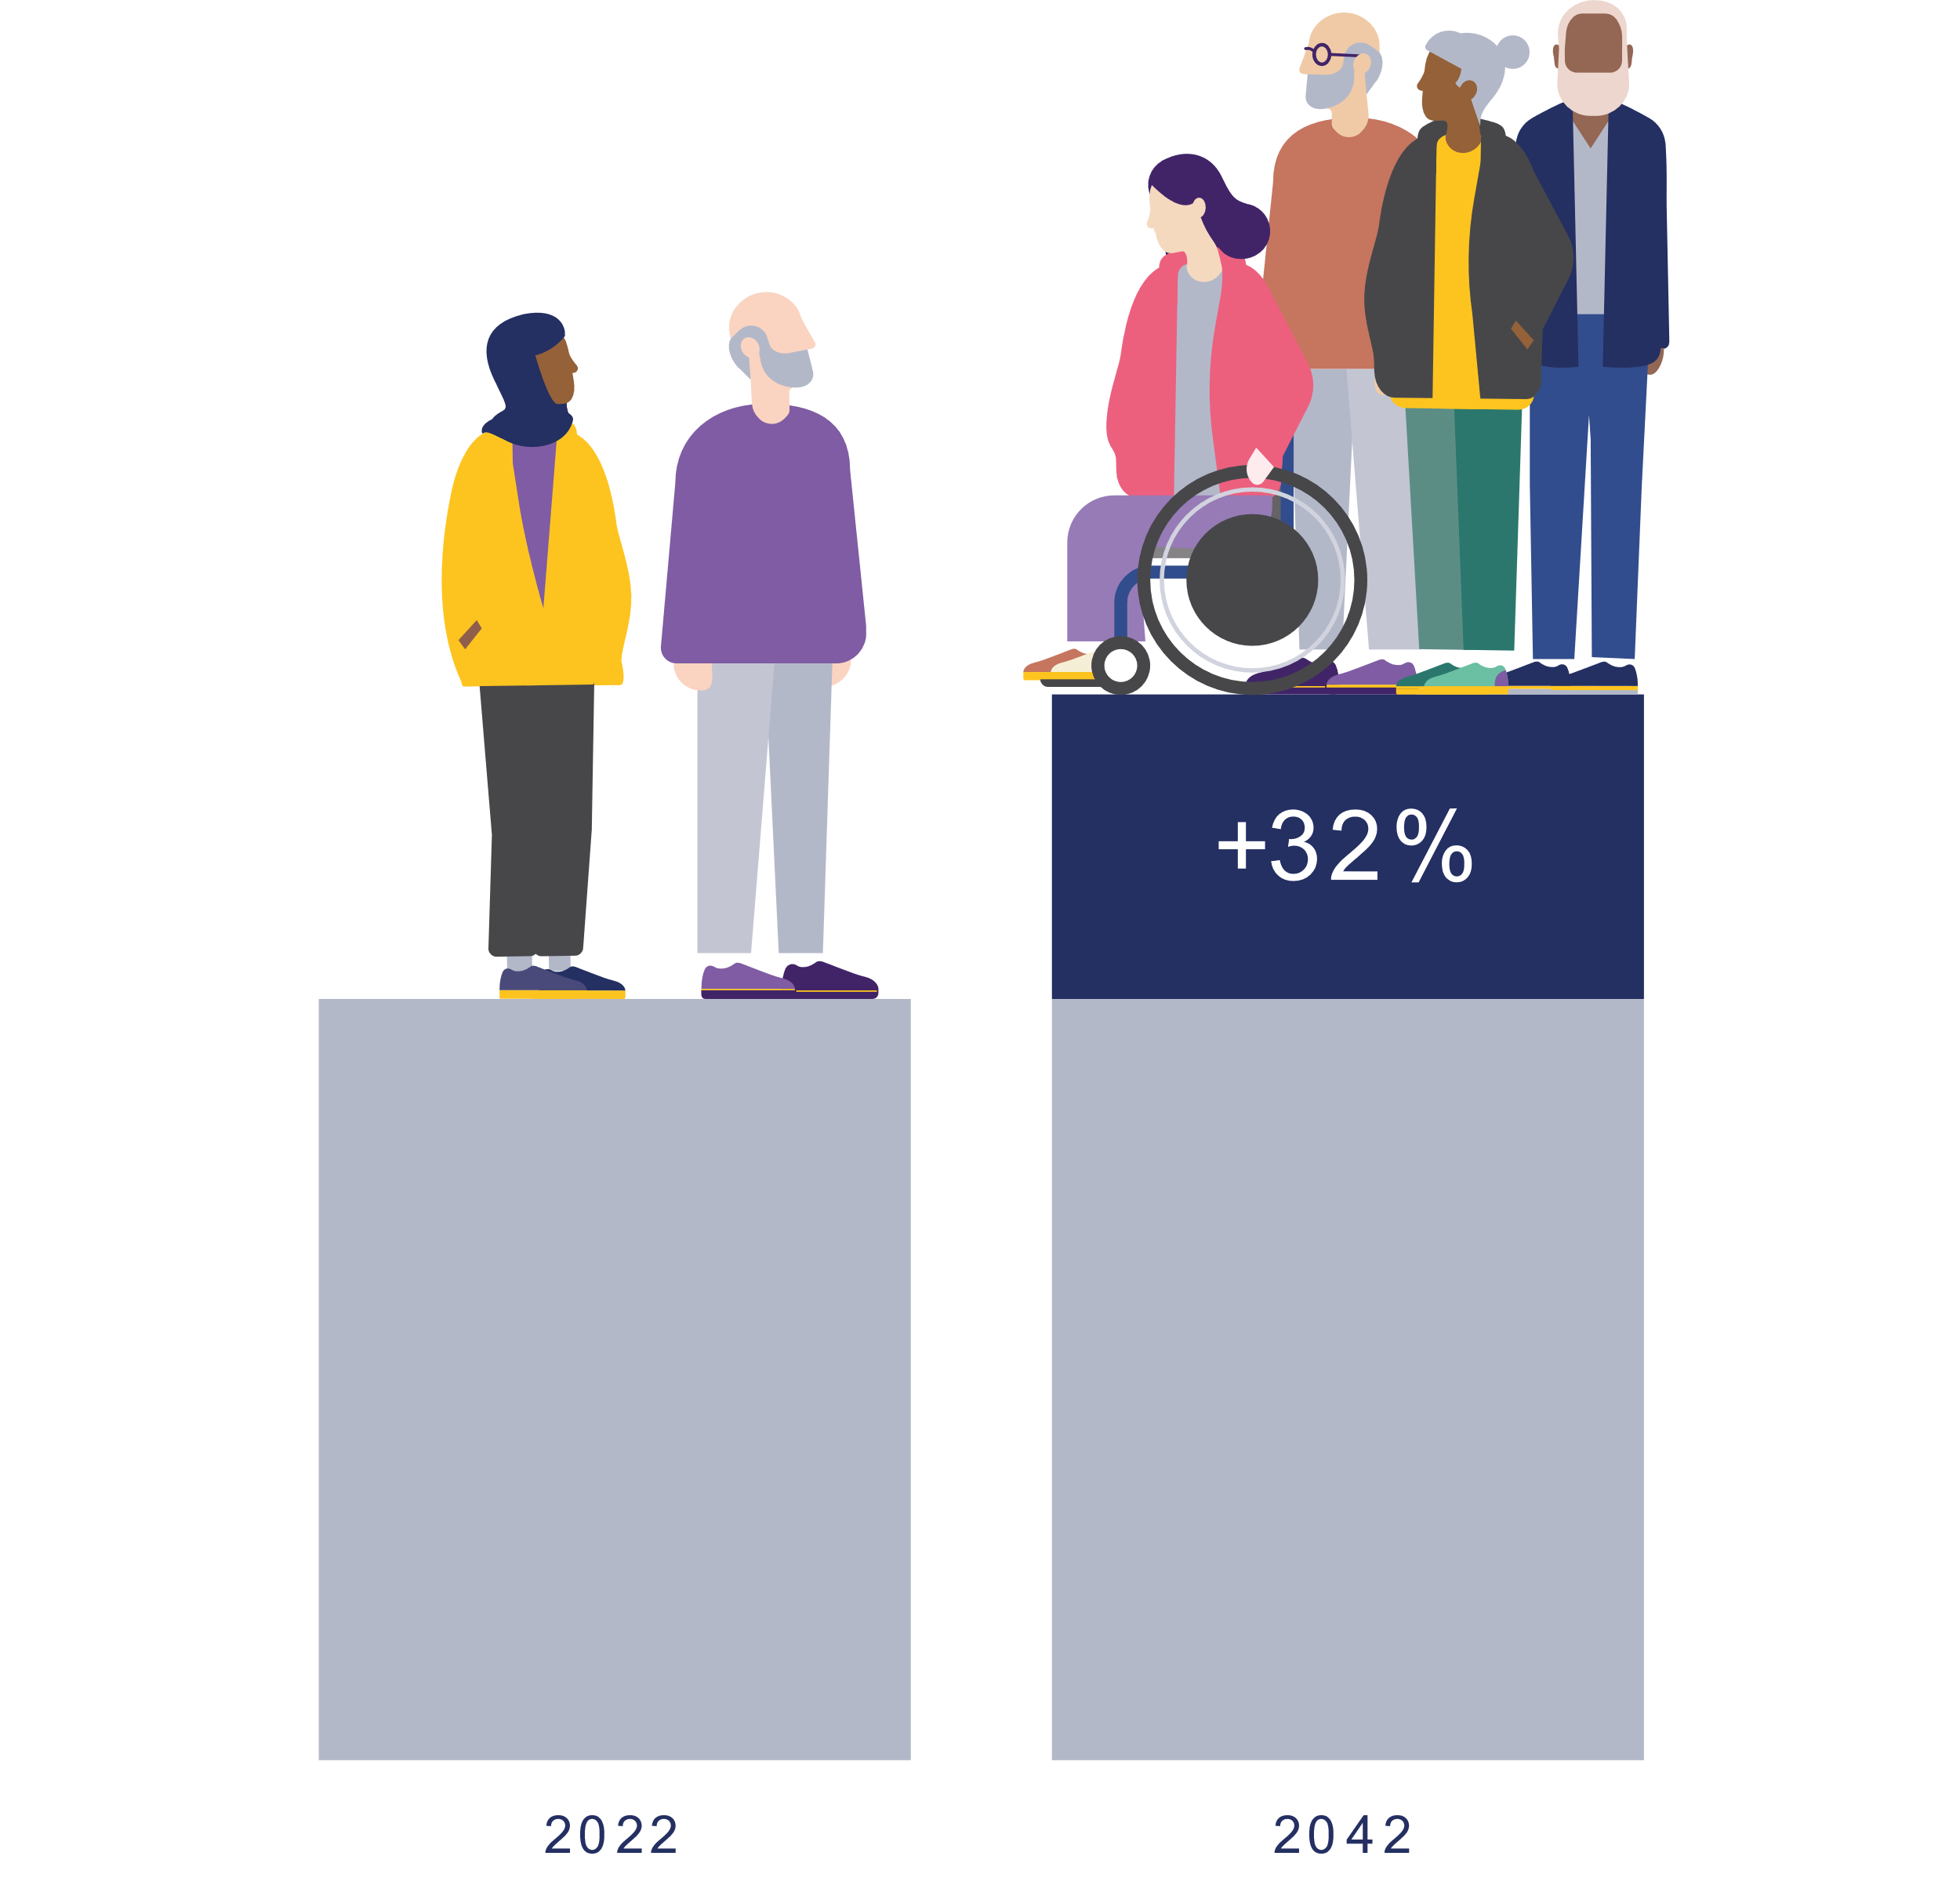

Our population
The population aged 65 and over in the UK is projected to increase by almost
a third in the next 20 years.
We’re living longer, and the age profile of our society is changing rapidly
Notes:
We were set up to look at the impact of the ageing population and how society needs to respond to it.
We are living longer than ever before and the age profile of our society is changing rapidly.
These changes will have big implications for all of us – including how we design our societies.

Slide 4
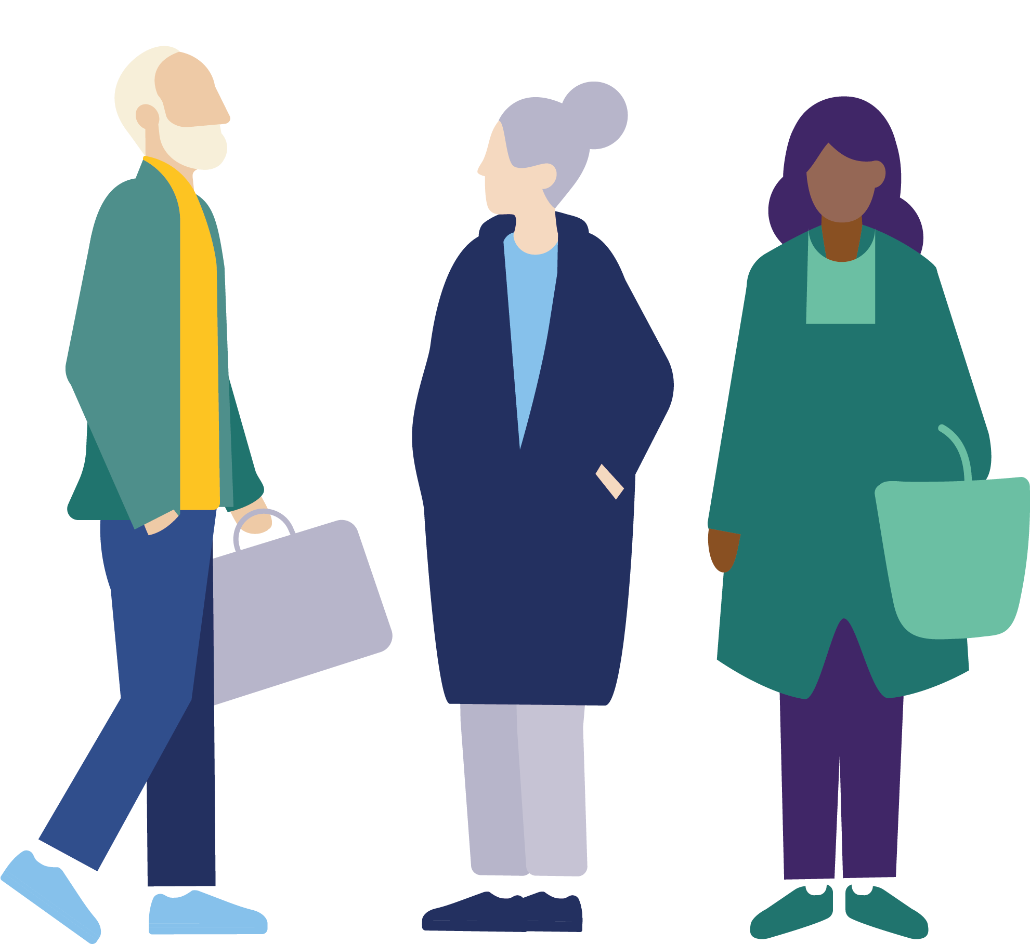
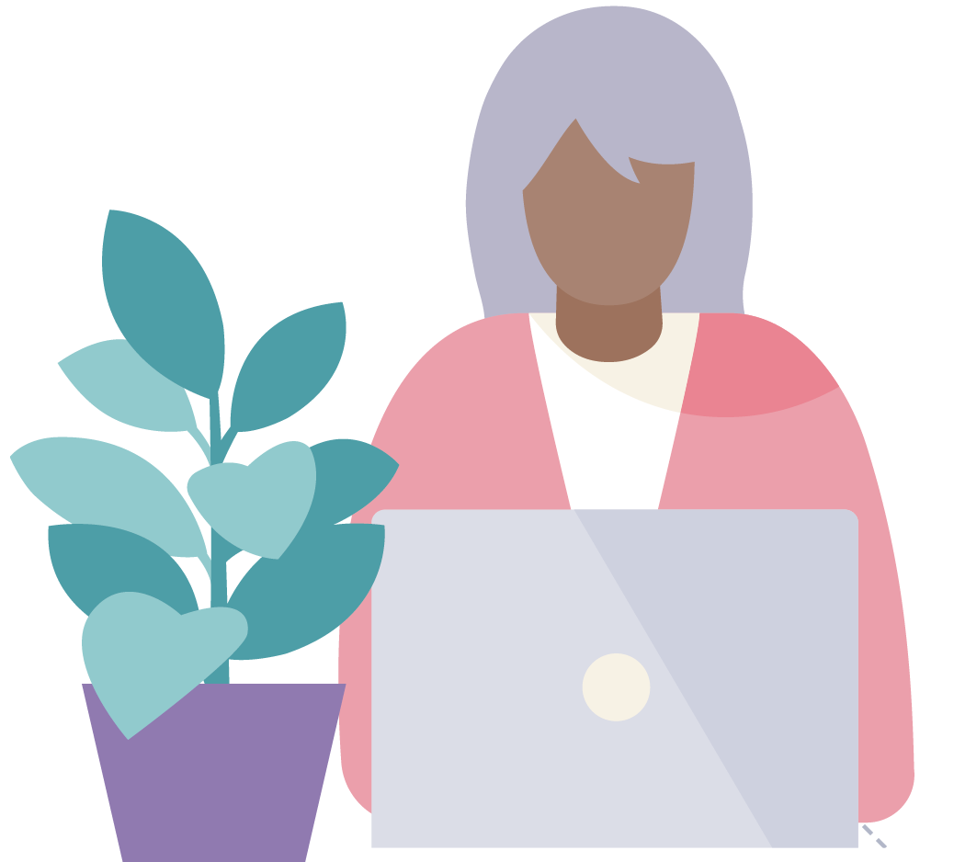
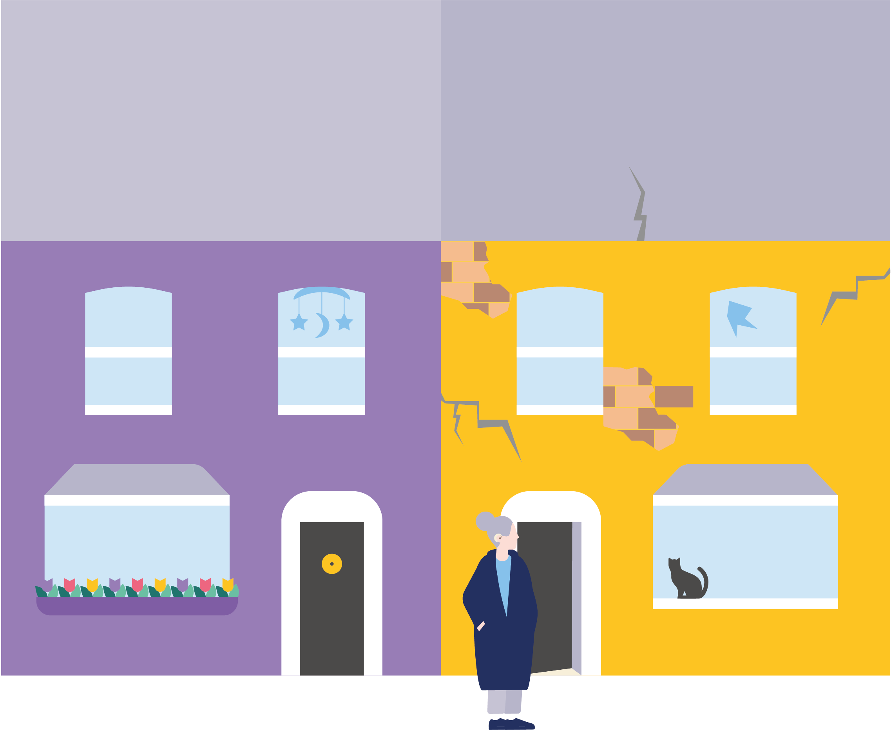
The Centre for Ageing Better
Age-Friendly Movement and tackling ageism
Age-Friendly Employment
Age-Friendly Homes
Notes:
The Centre for Ageing Better is a charity working to create a society where everyone enjoys later life. We are funded by The National Lottery Community Fund and part of the government’s What Works Network.
We work across three different areas -
We’re building an age-friendly movement across the country including a bold campaign to stamp out ageism.
We’re influencing policy and practice so that everyone has access to good jobs, that are right for them, through their 50s and 60s and beyond.
We’re working to ensure everyone can live in age-friendly, accessible homes in intergenerational communities.

Slide 5
What is ageism?

Slide 6
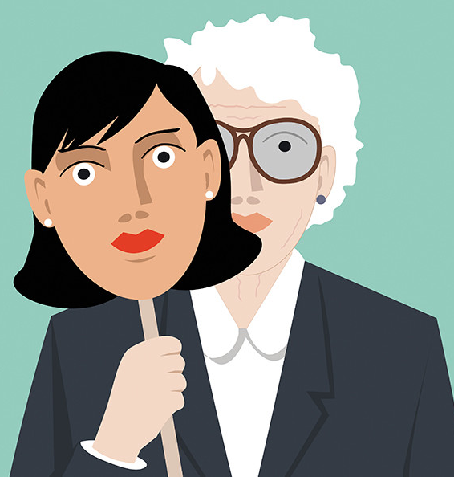
Ageism
Ageism is a bias against people based on their age
Ageism affects everyone
1 in 3 people within the UK report experiencing age discrimination
Ageism affects how society sees older people: they’re often reduced to stereotypes and treated as a burden.
It even affects how we see ourselves
Notes:
Ageism is a bias against people based on their age
WHO: refers to the stereotypes (how we think), prejudice (how we feel) and discrimination (how we act) towards others based on age.
Ageism affects everyone. From the minute we’re born, we’re judged according to how old we are. And it will impact us all at some point, particularly as we get older.
In the UK, it’s one of the most widespread form of discrimination, with 1 in 3 people experiencing prejudice because of their age.
Ageism affects how society sees older people: they’re often reduced to stereotypes and treated as a burden.
And it even affects how we see ourselves: as the years progress, we come to think that we’re ‘past it’ or ‘over the hill’

Slide 7
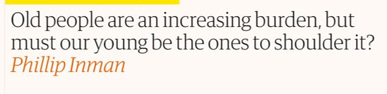
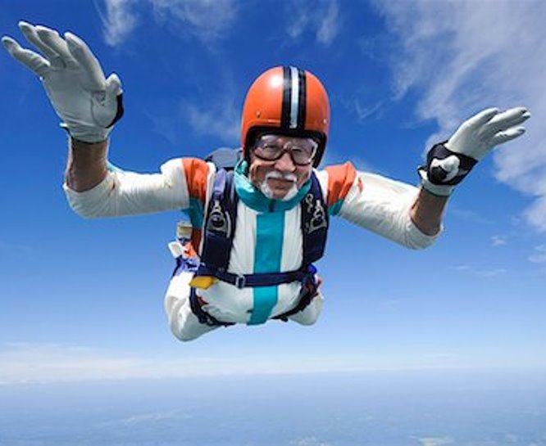
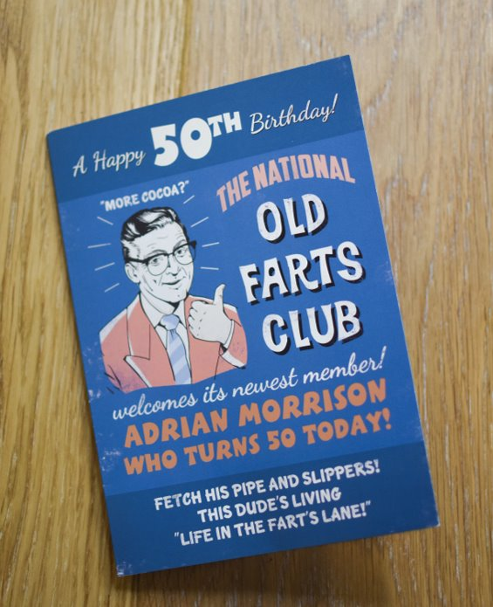
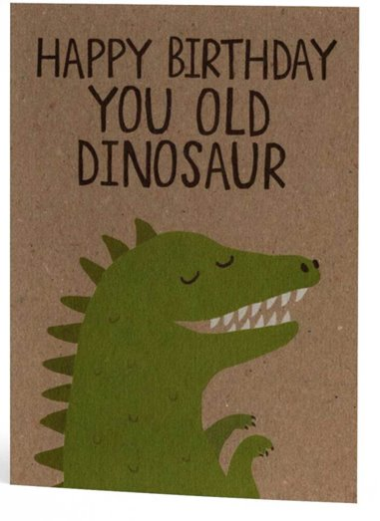
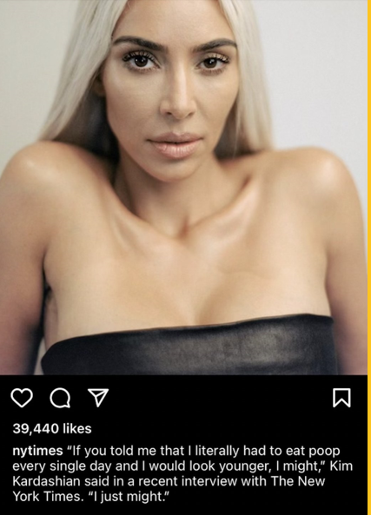
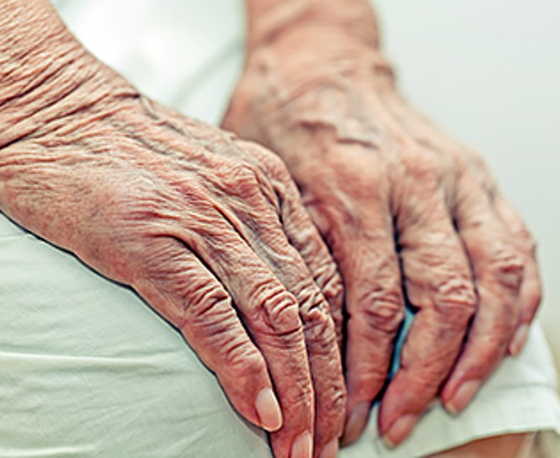
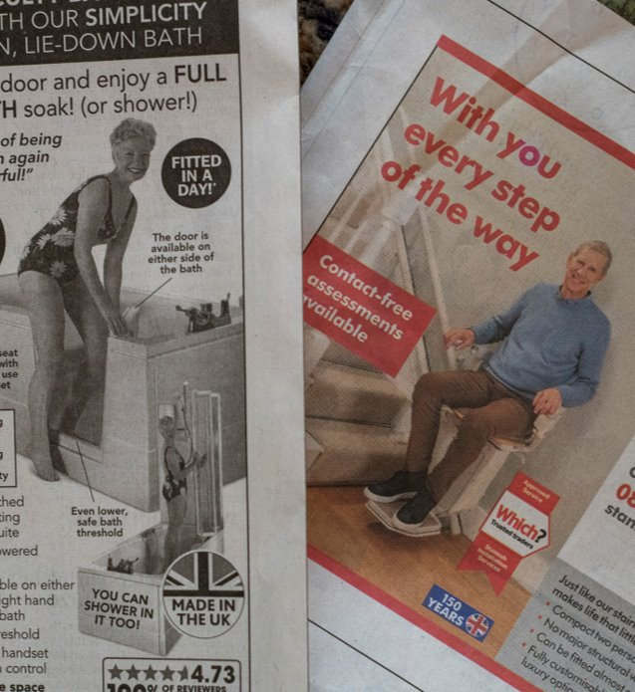
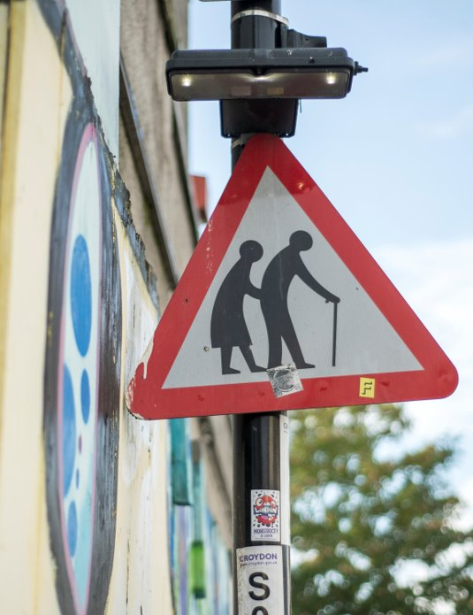

Notes:
AGEISM IS EVERYWHERE
Workplaces, healthcare, politics, media and advertising, even birthday cards
We are bombarded with messages that make us feel bad about getting older and try to make us believe it is something we can, and should, fight
From our research we know that ageist narratives can include
pitting age groups against each other
reducing people to stereotypes
portraying later life as a time of frailty and decline

Slide 8
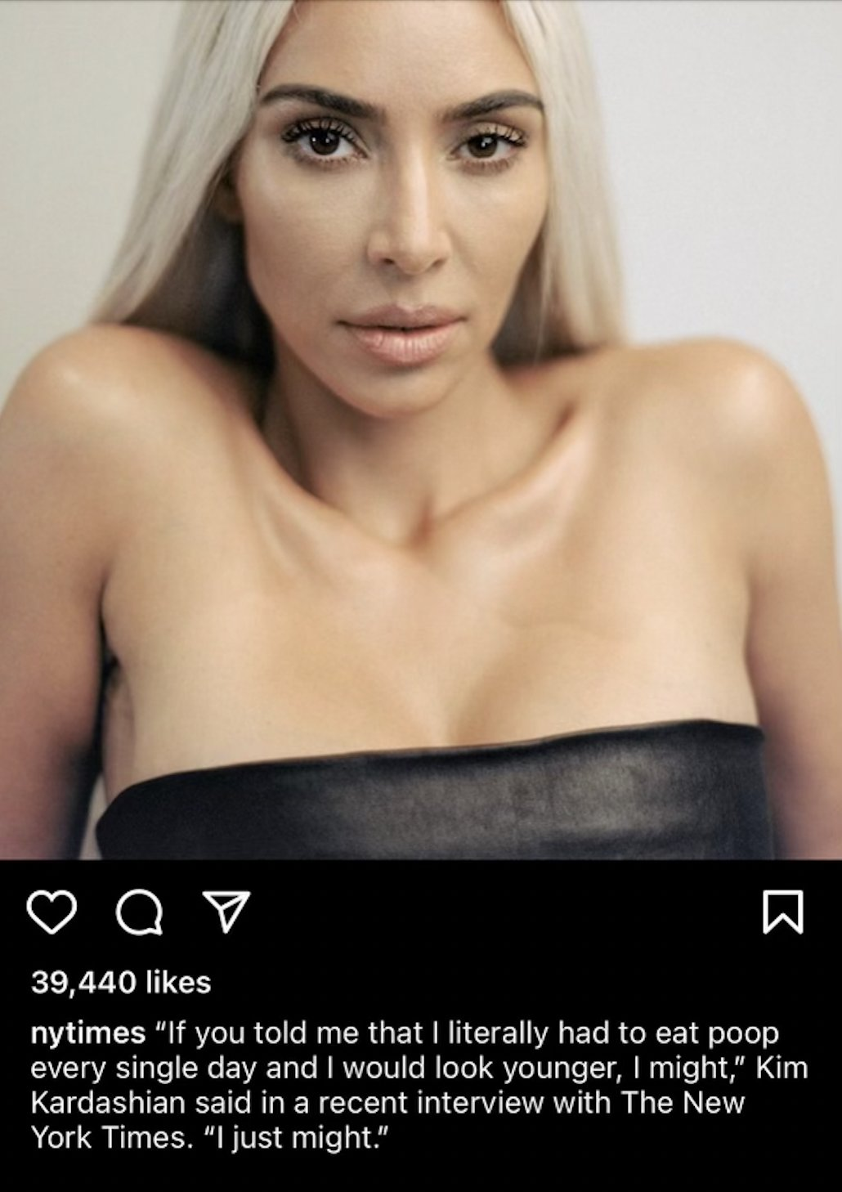
Notes:
Kim Kardashian, NY Times
A good example of which is how women’s ageing is often seen more negatively than men’s ageing – and much more closely linked to notions of beauty
It highlights that age can overlay with other characteristics such as ethnicity or gender so where already marginalised groups can face further prejudice as they get older, ageism can intensify the levels of prejudice they face.

Slide 9
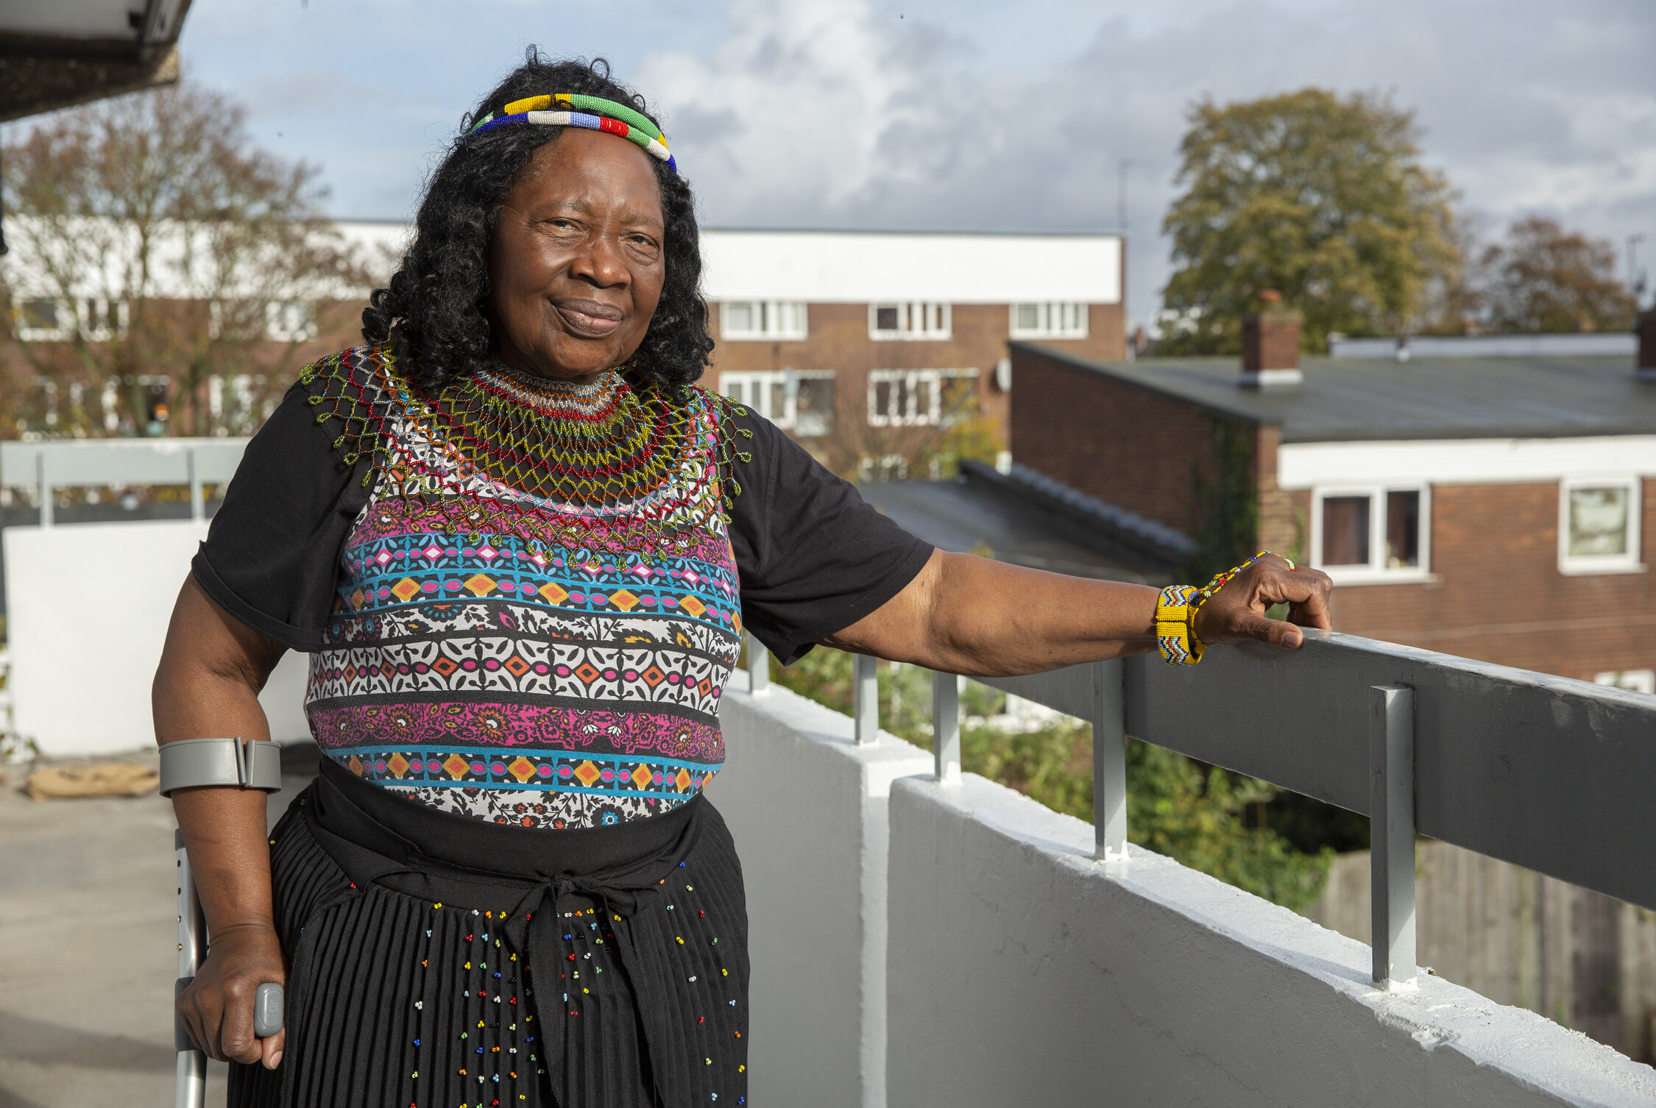
Intersectionality
Ageism can intersect with other forms of discrimination, including racism, sexism and disablism
Negative framing of ageing as synonymous with disease and disability suggests that ageism and disablism may have lots of overlap
We then define people by certain stereotypes

Slide 10
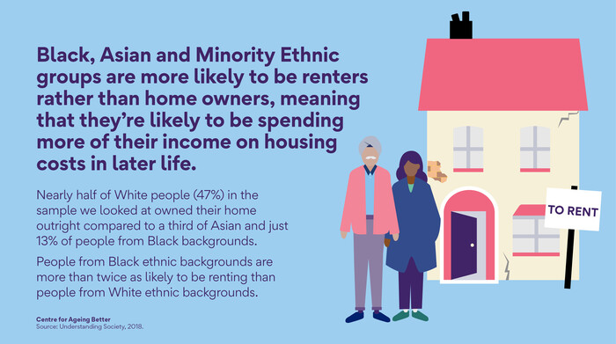

Slide 11
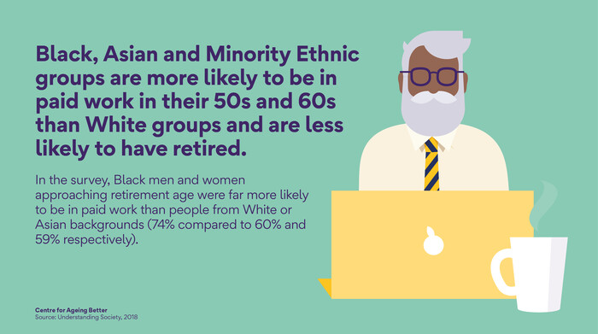

Slide 12
Why does Ageism matter?

Slide 13
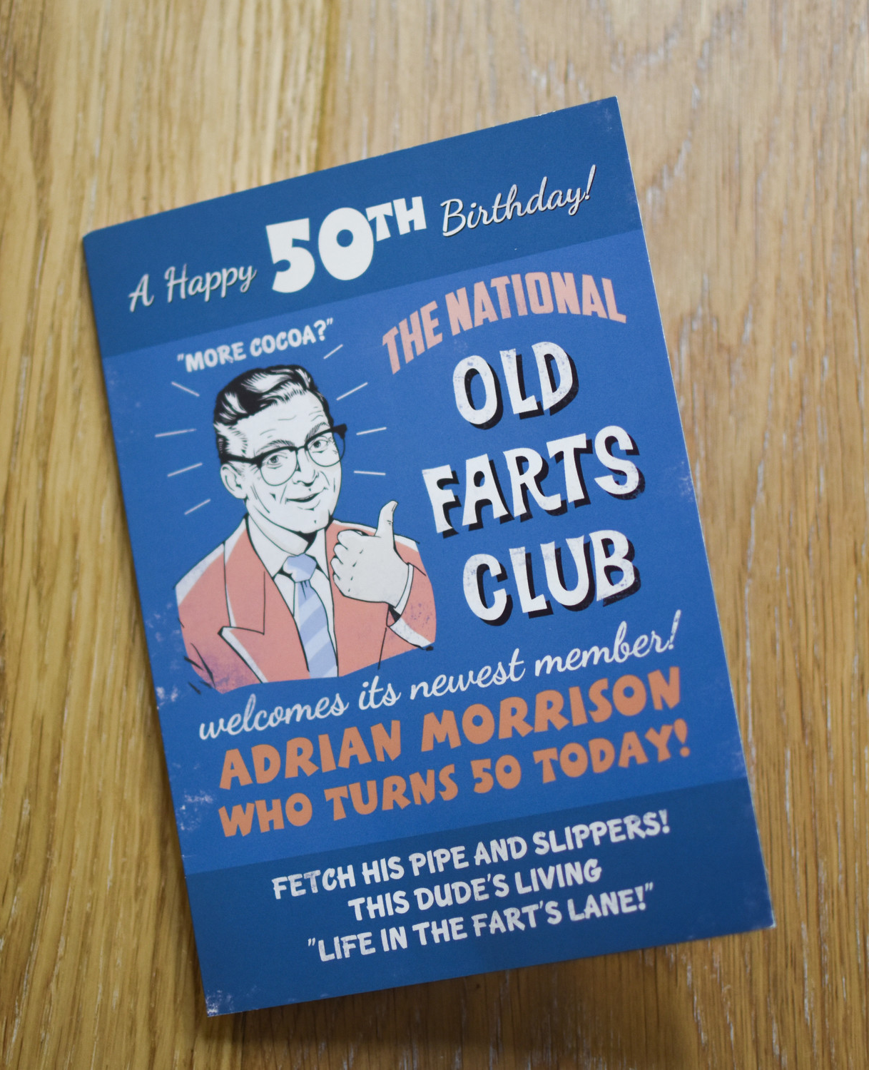
Everyday ageism
Work: older workers are seen as having lower levels of performance, and less ability to learn.
Housing: with a reluctance on the part of developers in recent years to build higher levels of accessibility into new homes
Health and social care: ageing seen as an inevitable process of increasingly bad health.
Media and advertising: Skills seemingly become invalid at a certain age, and over 50s absent from the marketing of everyday products.
Notes:
We also know of the real-world impact this ageism can have . It can cause a huge range of harms, in a wide range of contexts
The workplace is one area that ageism most clearly manifests - for example, we know over 50s get fewer opportunities for training and progression than younger peers, and are seen as having lower levels of performance, and less ability to learn. 36% of 50 to 70 year olds saying that their age would disadvantage them in applying for jobs.
Housing: A focus on ‘first time buyers’ ignores the fact that homes need to be designed for all ages. Less than ten per cent of homes have basic features that make them accessible for all ages and abilities. Also seen with a reluctance on the part of developers in recent years to build higher levels of accessibility into new homes. There’s also a particularly pernicious narrative around downsizing which is based on the idea that people at a certain point in their lives are taking up too much room and should make way for younger people.
Another area is health care - Studies suggest age might impact people’s access to treatment – for example, older people with mental health problems are more likely to be prescribed anti-depressants and less likely to be referred for talking therapies. During the pandemic, we ‘do not attempt resuscitation’ decisions being made without consultation with individuals or their families.
Media and advertising: Skills seemingly become invalid at a certain age. Countdown presenter Anne Robinson joked that she’s the oldest woman on TV who’s not judging cakes. In advertising, over 50s are largely absent – at least from the marketing of everyday products and the industry itself could even be described as anti-ageing. This is despite over 50s accounting for 54% of total household consumer spending.

Slide 14
How does the way we talk about older age and ageing impact on ageism?

Slide 15
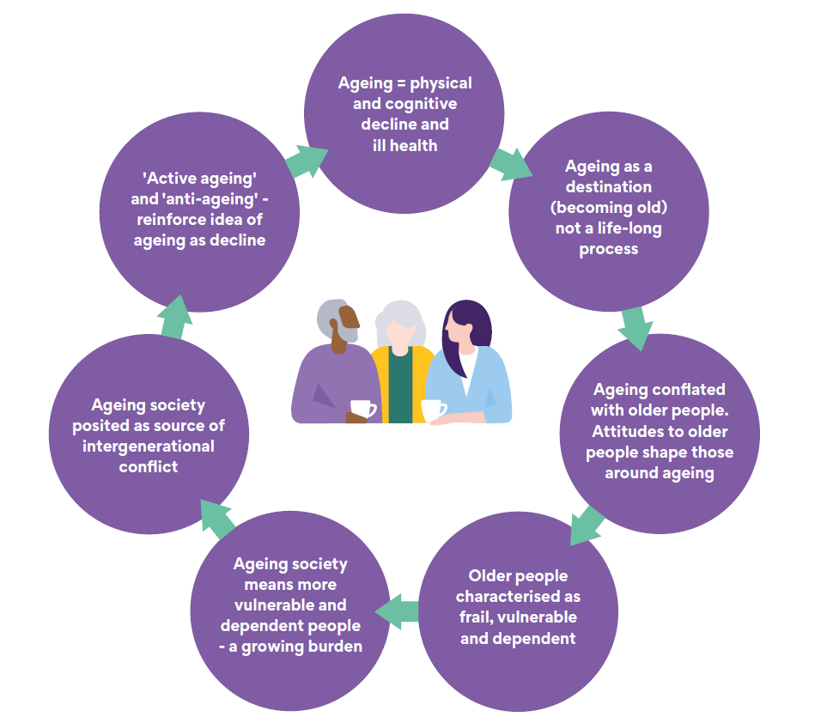
What we hear about ageing in public life
Notes:
What does society really think about ageing ?
We are working on a project to try to get to the root of this stuff and to try to develop a more constructive and realistic narrative on ageing that resonates with the public
Last year we launched a report which analyzed the way ageing and older people are talked about across different sectors. We looked at thousands of texts from across different sectors and industries (politics, media, advertising and charities) to test that and try understand the dominant themes – some key ones:
Ageing or being old automatically being seen as a time of decline – you hear people saying they’re past it, over the hill, washed up. This idea that people inevitably lose their ability and faculties as they get older.
Older people being characterized as frail, vulnerable and dependent – we saw a loot of this in all the media coverage around COVID-19
The ageing population or older people being a burden on society, an expensive and a drain on resources – also this idea of a competition for resources and older people having it all at the expense of younger people.

Slide 16
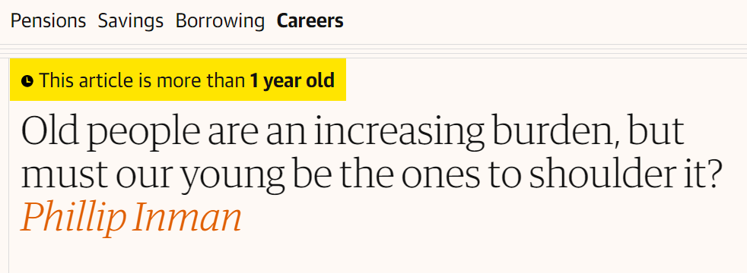
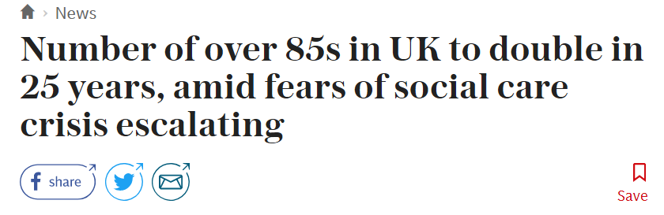
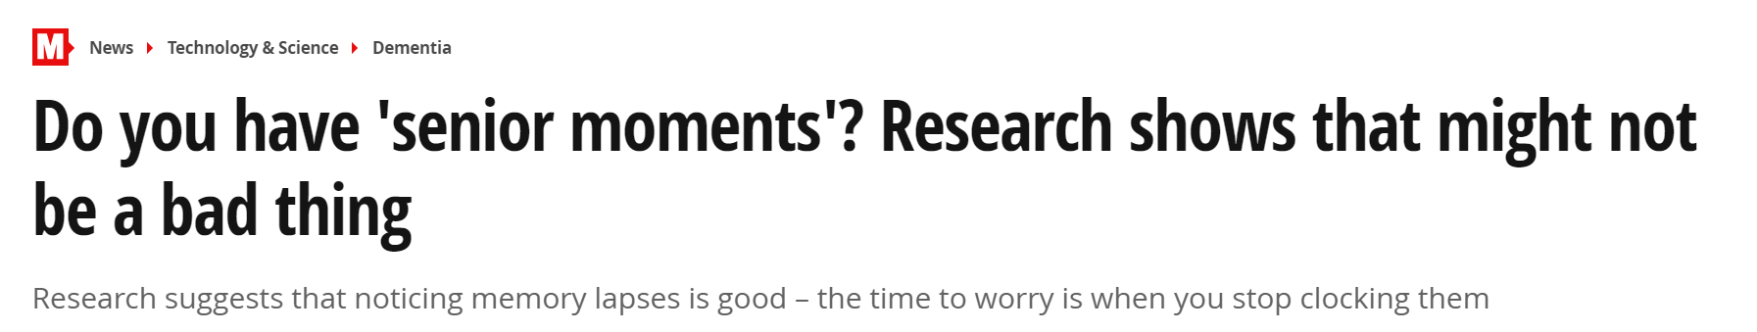
How the media talks about ageing and older age
Represented as a time of inevitable decline towards frailty and ultimately death
Older people framed as inherently vulnerable – particularly in the context of scams
Tabloids tend to tell stories about individuals experience a crisis, whereas broadsheets tend to tell stories about services and society in crisis
Social media often caricatures older people, particularly in terms of gender. However, also offers a chance to speak differently about age.

Slide 17
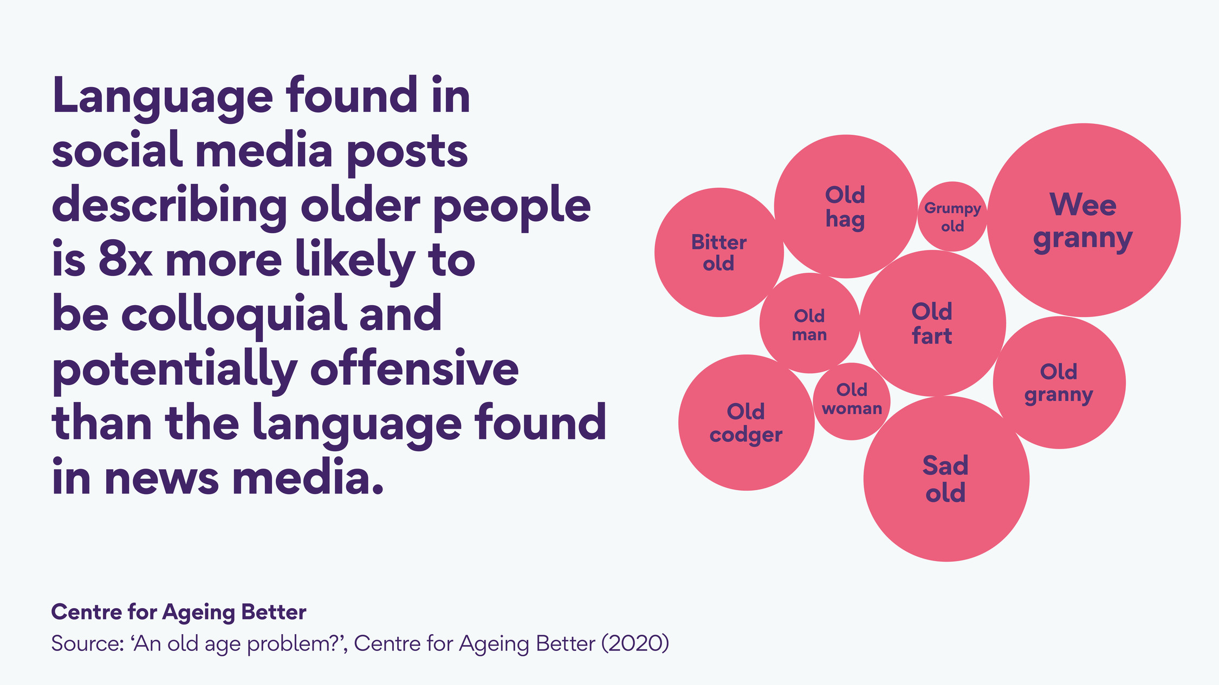
Notes:
Social media also has caricatures of older people, which can often be gendered, with women often portrayed as either looking ugly and unpleasant (e.g. ‘old hag’) or being referred to in a much more patronising manner (e.g. ‘little old lady’). Older men are often described in such a way that suggests they are stuck in their ways (e.g. ‘old codger’) and sometimes as creepy (e.g. ‘dirty old man’).

Slide 18
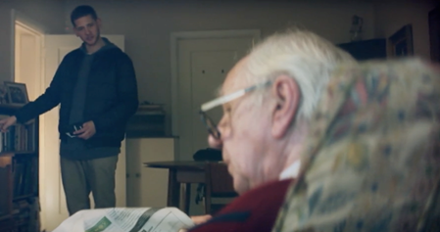

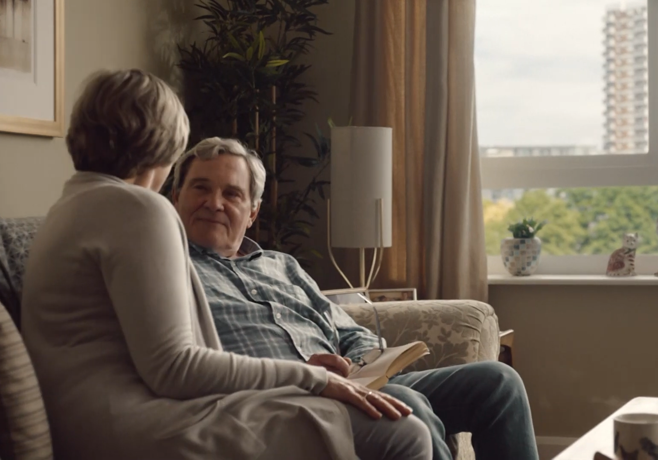
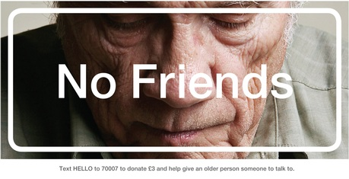
How adverts talk about ageing and older age
Also caricatures older age – argued by stakeholders to be necessary due to how products are sold
Seemingly positive language more common, but themes of death and decline still apparent – e.g. ‘anti-ageing’ products
Adverts tend to portray older people as all the same: powerless to affect their own lives and often not being very active
Notes:
Often very muted colours with passive actions – i.e. sitting around drinking tea

Slide 19
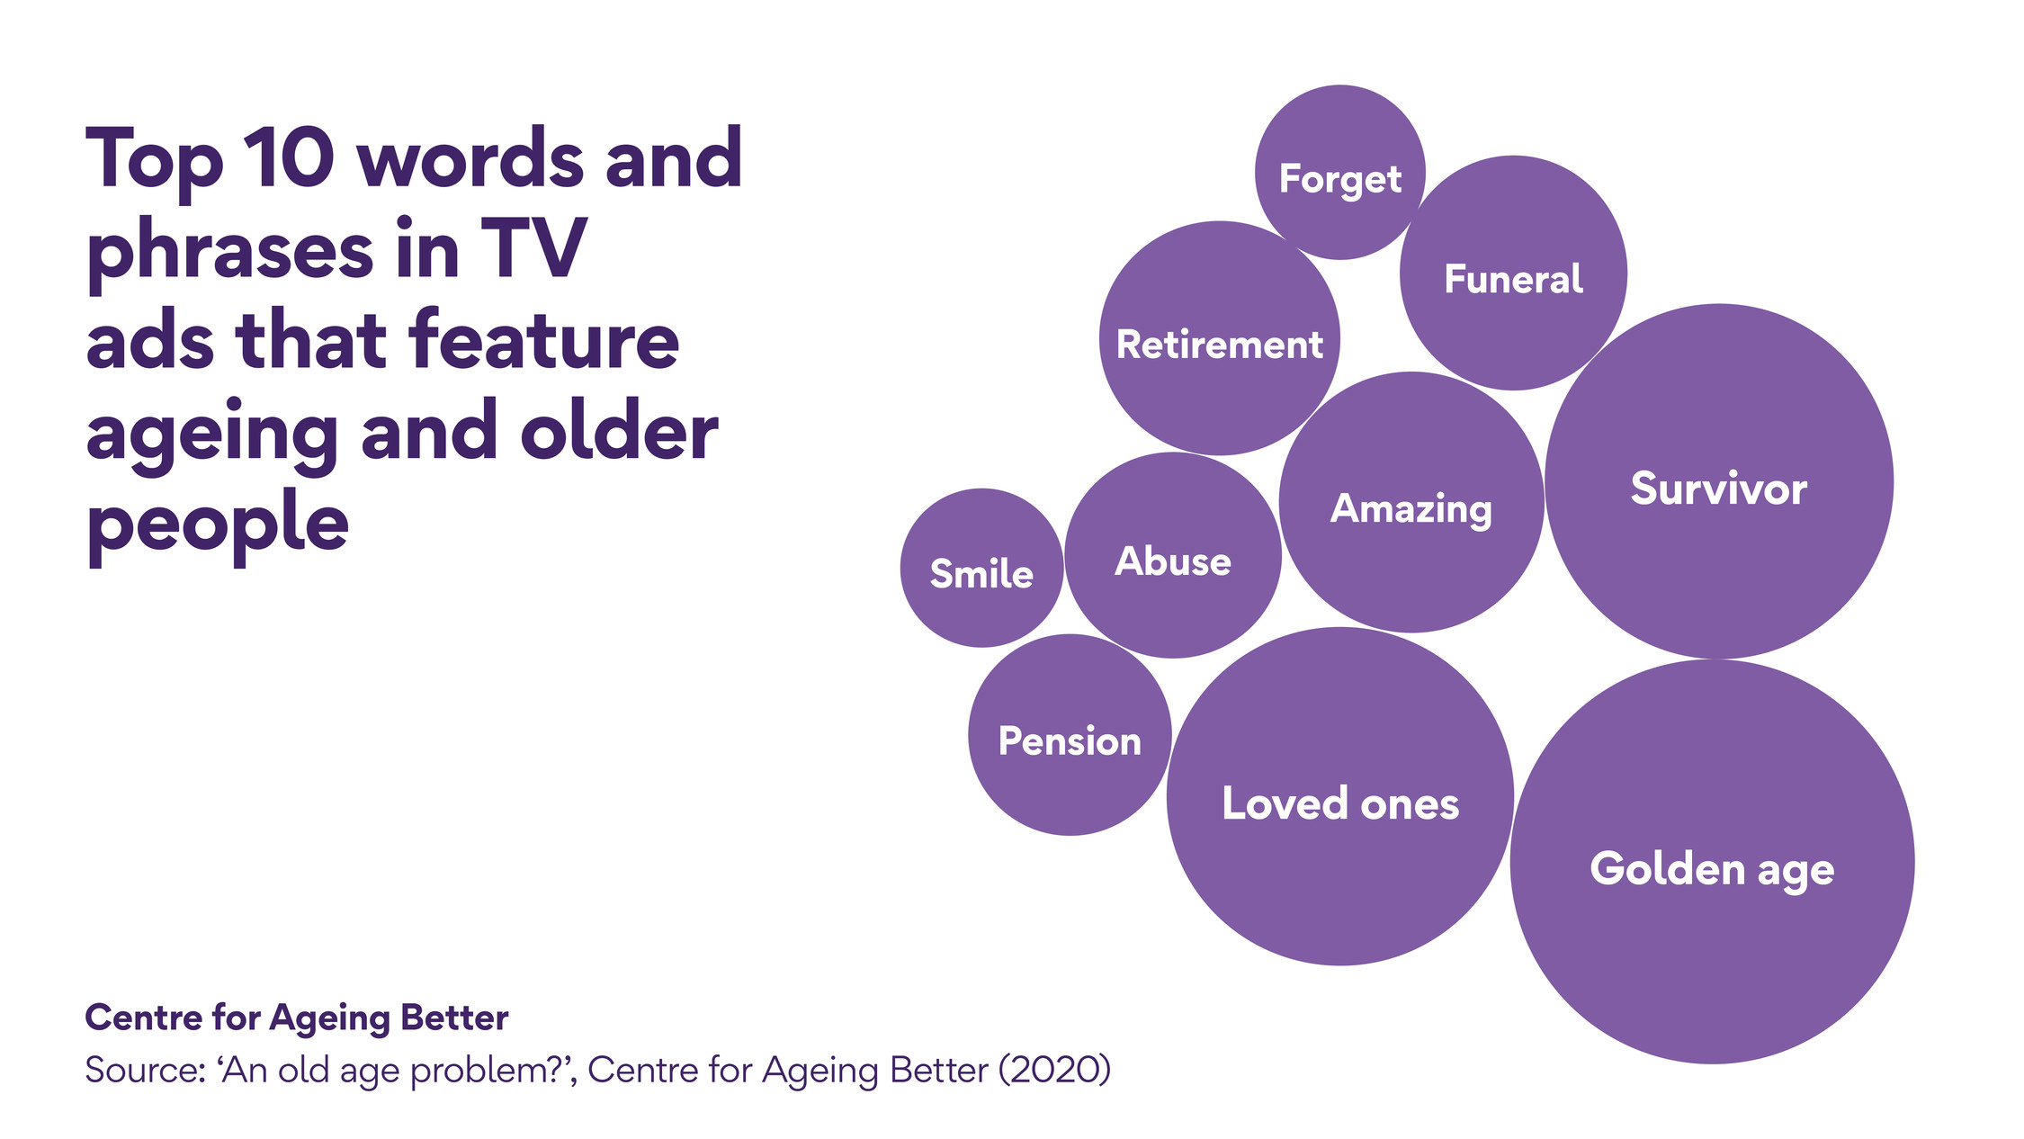

Slide 20
Imagery
Notes:
Are images used in the UK, across different sectors like media, advertising and by the public representative and inclusive when it comes to age
Short answer is ‘no’

Slide 21
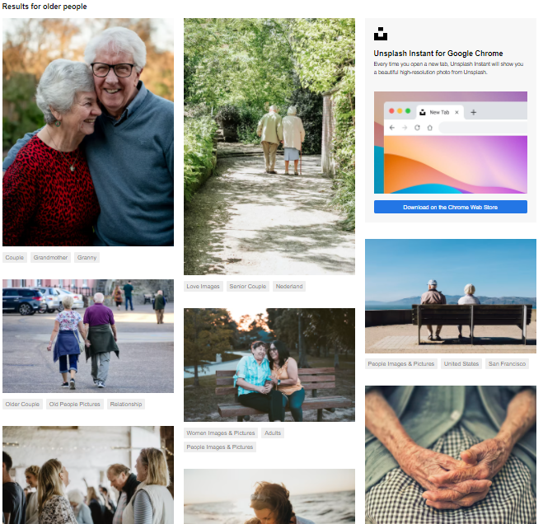
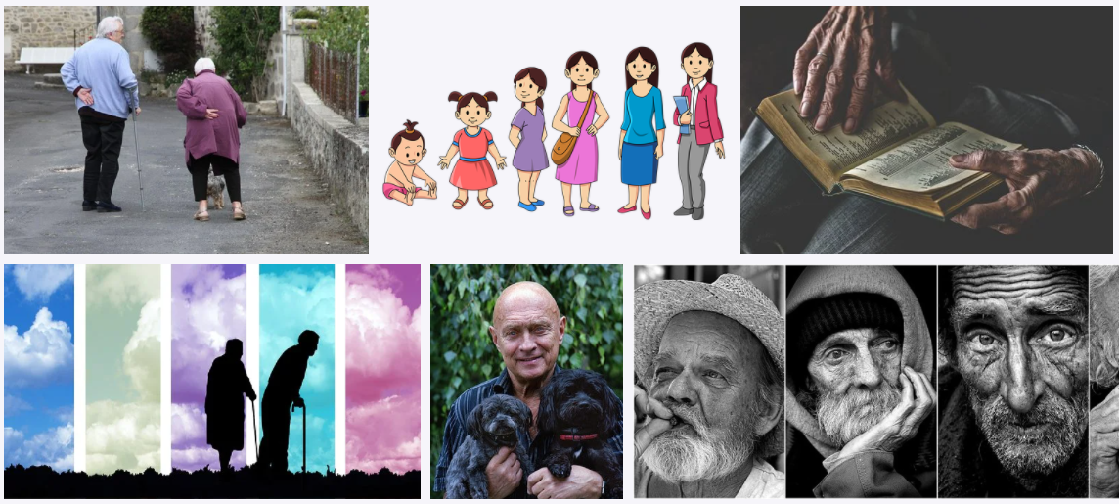
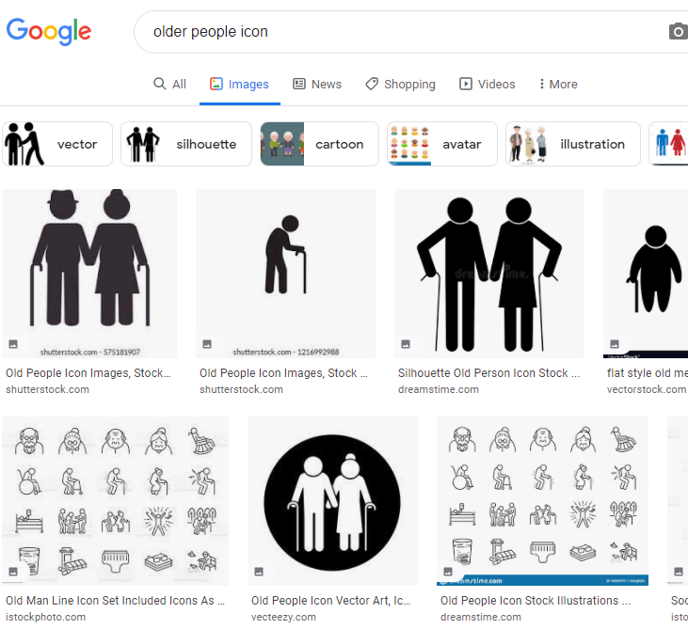
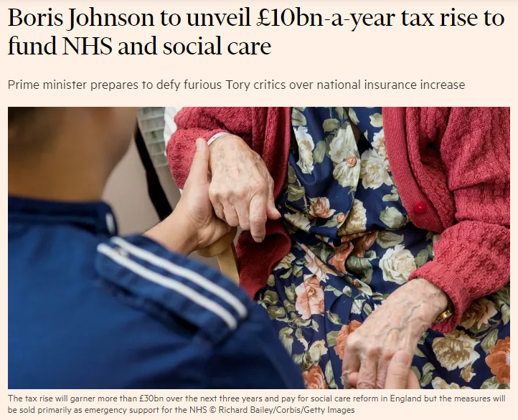
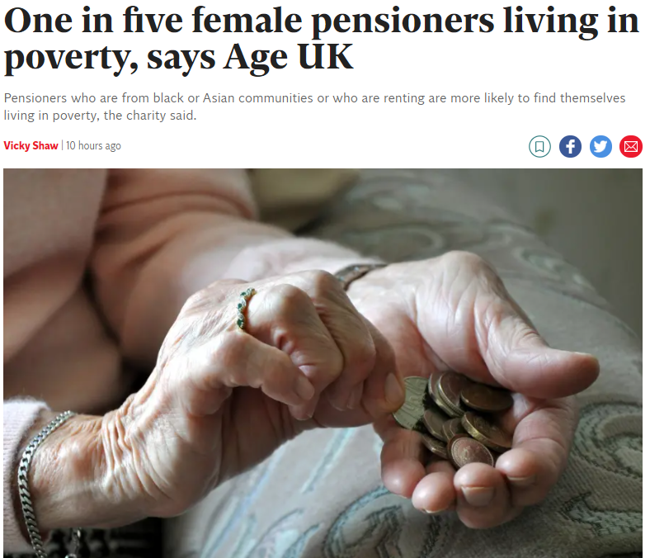
Notes:
Here are some more examples of images that appear in the media regularly and that are the first results in google and image libraries
Unfortunately, we’re highly reliant on outdated and negative stereotypes - vulnerable pensioners, older people framed as inherently vulnerable or lonely
Often, depictions show older people are homogeneous and disempowered, and later life as something that’s to be feared
Very muted colours with passive actions – i.e. sitting around drinking tea ​
The reality is the opposite. Older groups more diverse
e.g. 90% of people over 65 live in mainstream housing, but adverts neglect the diversity of later life​
​
Part of the problem is that older age groups are absent from the marketing of general consumer products – phones, cars, washing machines- Most advertising features the under-40s. ​​

Slide 22
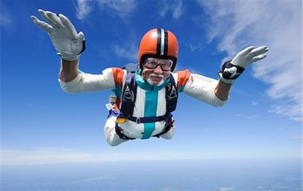
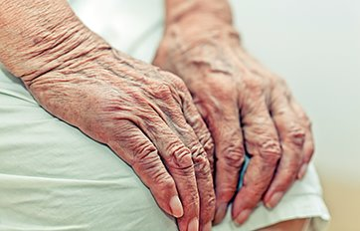
Depictions of older people
Older people are presented as more of a burden than a benefit
There is a dearth of images of older people, particularly older women and disabled older people
Images aren’t representative or realistic
Notes:
Our literature review found that within the print media especially, older people are represented as more of a burden than a benefit, described as frail non-contributors to society.
It also showed that there’s a real dearth of images of older people, particularly older women and disabled older people
Images aren’t representative or realistic: The two examples included here are often the stereotypes found – extremes of either affluent and remarkable older people or people who are reduced to wrinkly hands and dehumanised

Slide 23
What do we think about ageing and older age?
Notes:
From our public perceptions work – including focus groups and surveys

Slide 24
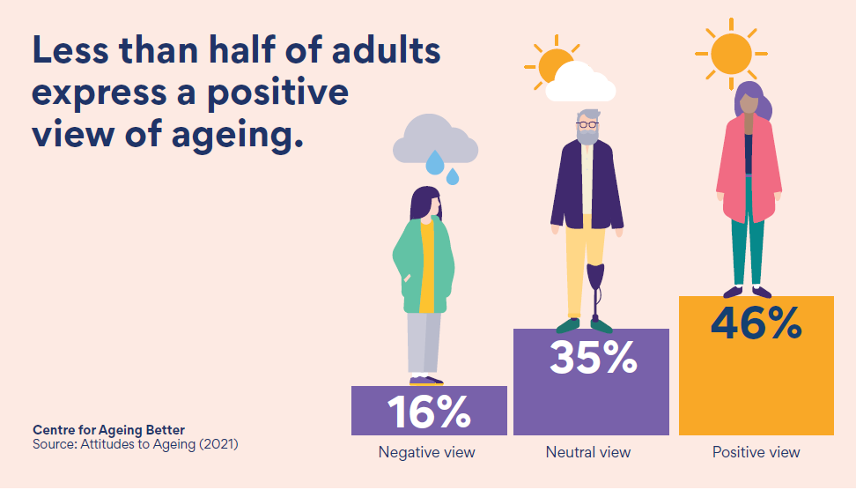

Slide 25
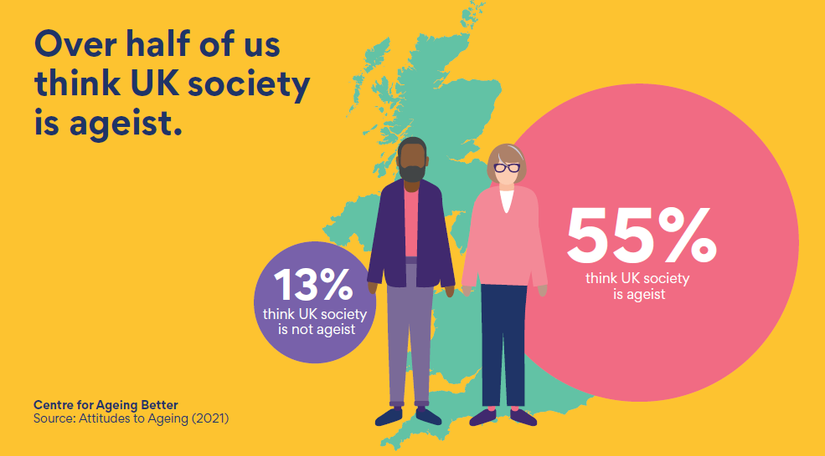

Slide 26
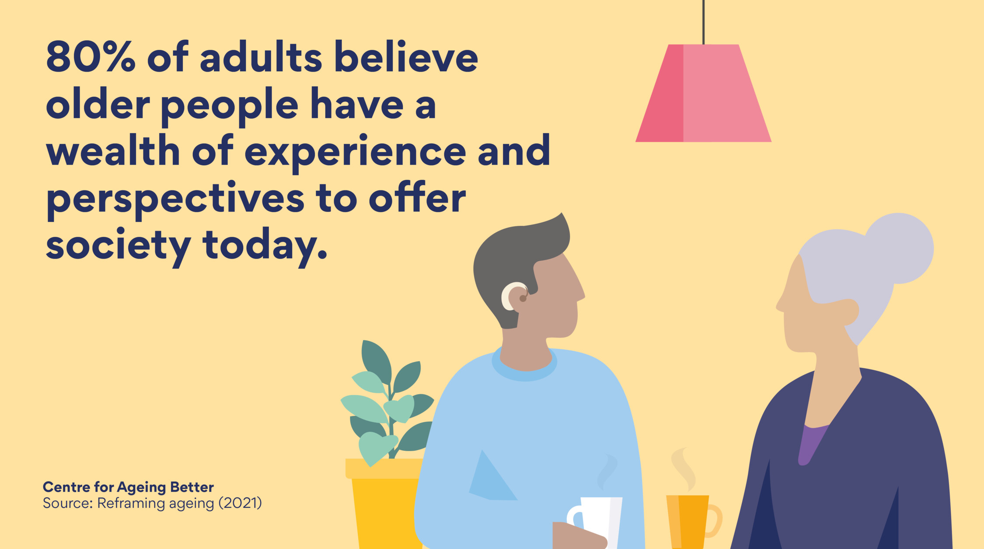
Notes:
It doesn’t match public opinion.
80% of us believing that we could all benefit from the wealth of experience that older adults have.
And the apparent ‘crisis’ of our so-called our ageing population…

Slide 27
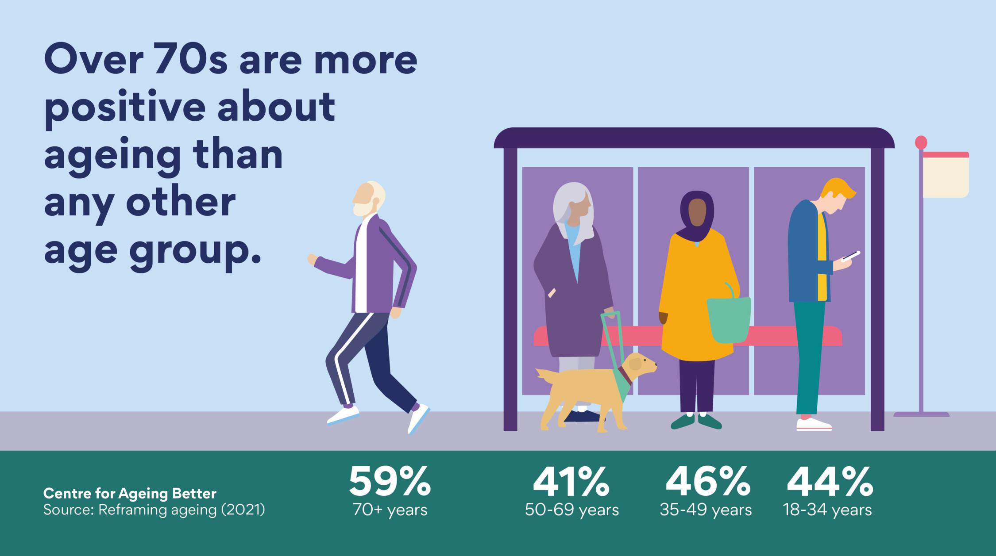
Notes:
Despite people not expressing a positive view of ageing
In fact, life satisfaction is at its highest in later life.
And the inter-generational conflict stoked by the media…

Slide 28
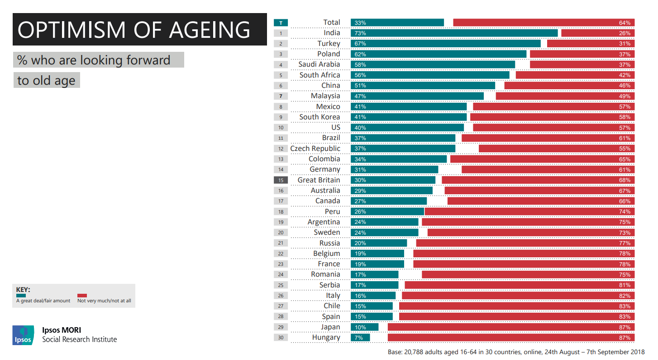
Notes:
The way we talk about age influences the way we feel about the ageing process and the way we act towards people in different age groups. One of the biggest obstacles we face when it comes to embracing later life is the negative way we think and talk about it.
Overall, we are pretty downbeat about our later life – in a piece of research we did with Ipsos Mori only a third of people said they were looking forward to older age and Half (50%) said they worry about getting old.
Keep in mind that age discrimination isn’t just unfair, it’s illegal. Just like racial or gender-based discrimination, it’s illegal to discriminate against someone based on their age.

Slide 29
Why a campaign?
Ageism is the most widespread form of discrimination – 1 in 3 experience it
It affects all ages but its damaging impact is felt most profoundly as we get older
Ageism limits lives, health and wellbeing and leads to people being devalued and marginalised as they get older
Our ageing population and longer lives brings urgency
It has damaging consequences for our economy and wider society
Notes:
Aware that some of our newer trustees won’t have heard about our rationale for the campaign, so here’s a brief reminder about what we know about ageism:
Ageism is the most widespread form of discrimination in the UK, with 1 in 3 experiencing age-based prejudice or discrimination.
It can happen at any age though the impact is felt particularly as we get older.
Ageism is often dismissed as being harmless, but the evidence overwhelmingly shows that it causes significant damage to individuals, the economy and society. It affects the way people think about themselves and treat other people. It leads discrimination in the workplace, in healthcare settings and in people limiting their own behaviour including healthy behaviours. And ultimately it leads to society failing to invest in ways to help people age well.
And the fact that the UK’s population is ageing lends urgency to the need to do something about this.
Ultimately If we are to bring about real change as an organisation, and create the conditions for wider change around ageing, we need to try to create an attitude and culture shift

Slide 30
Building an age-friendly movement – forthcoming campaign
Notes:
Last year we released our new guide, supporting the media to represent ageing in a more positive and realistic way.
These principles are taken from that guide. And I will share a link to that with everyone afterwards.

Slide 31
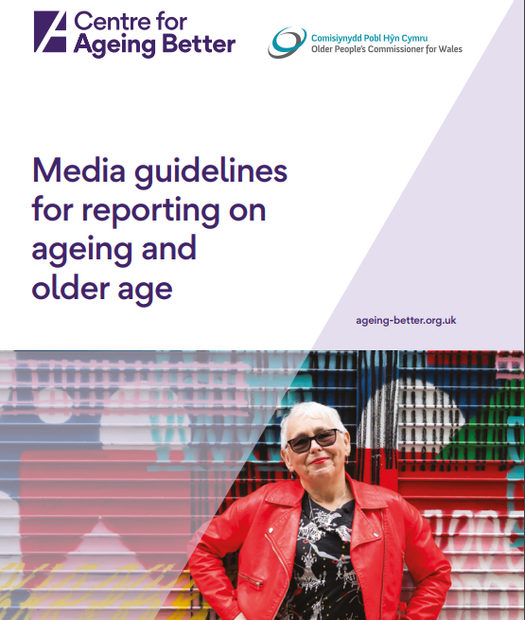
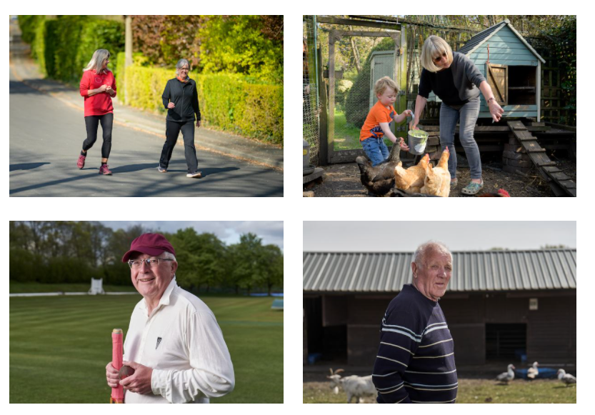
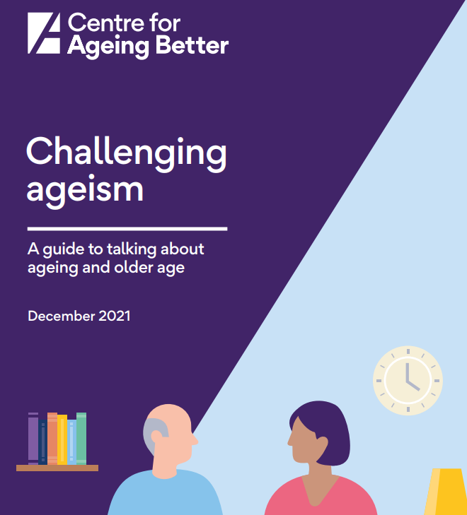
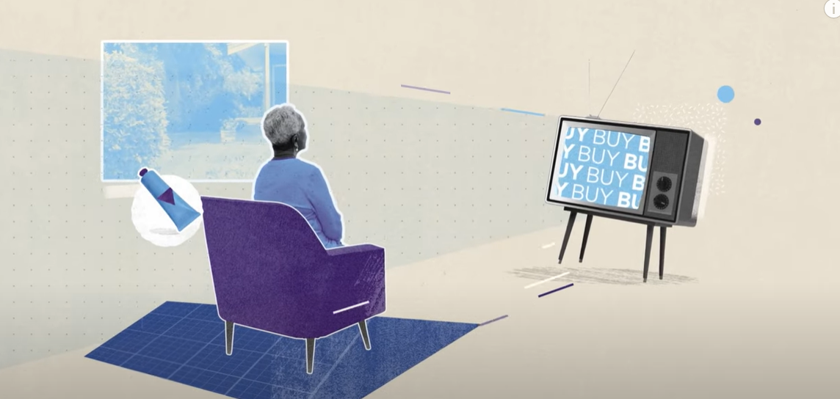
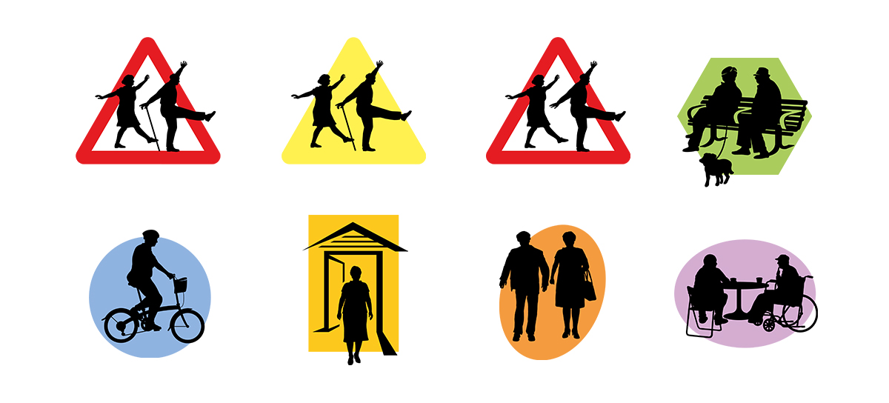
Notes:
OUTPUTS
Guidance for talking about age (including age-friendly comms principles)
image library
age-positive icons
Explainer film with almost 12k views

Slide 32
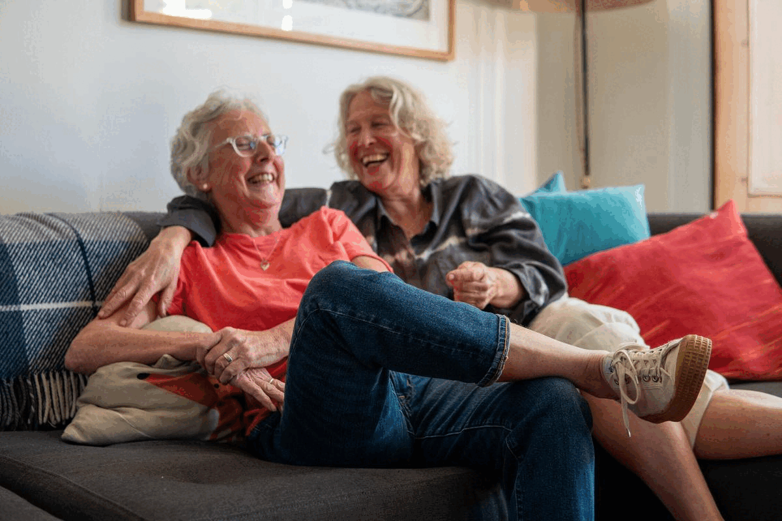
Notes:
We've created the first free library showing positive and realistic images of over 50s in a bid to challenge negative and stereotypical views of older age.
All the images are free to download and use online and in print
The library, which contains more than 2,000 images and is regularly updated, offers journalists, organisations and individuals a wide selection of images.
We’ve also produced an accompanying guidance around commissioning and taking your own age-positive images.

Slide 33

Ageism explained

Slide 34
Support our campaign!
Launching in October
Three years
Three key components every year to shift public attitudes at scale:
    Mass reach advertising - targeted at audience we want to shift but reaching a wider audience
    Action day – collective action, targeted at our “warmer” audiences
    “Always on” campaigning – mini-campaigns, PR moments and commentary throughout the year
Robust evaluation and process of refinement built in
Draws on experts, learning from other campaigns and people who have experienced ageism
Notes:
We’d love to have businesses and employers on board, supporting our campaign launching this autumn
It will be the UK’s first campaign designed to shift public attitudes at scale, and we’ll planning to do that in three ways
Mass marketing campaign – mass reach advertising and promotion – doing that every year
Action day – collective action, targeted at our “warmer” audiences
“Always on” campaigning – mini-campaigns, PR moments and commentary throughout the year
Working with a range of experts and people with experience of ageism to develop plans, and with the WHO on measuring impact.
We’d love for you to join us in amplifying the campaign and its messages, and to consider taking part in our action day. Likely to take place in February or March and run every year, we’ll be asking people t host events and actvitties so that could mean running an event in your offices or putting messages out through your networks and channels. And if you are an AFE or taking steps or better underrsand older customers, it will be a great time to shout about and get recognition for it!

Slide 35
Campaign for a Commissioner for Older People and Ageing

Slide 36
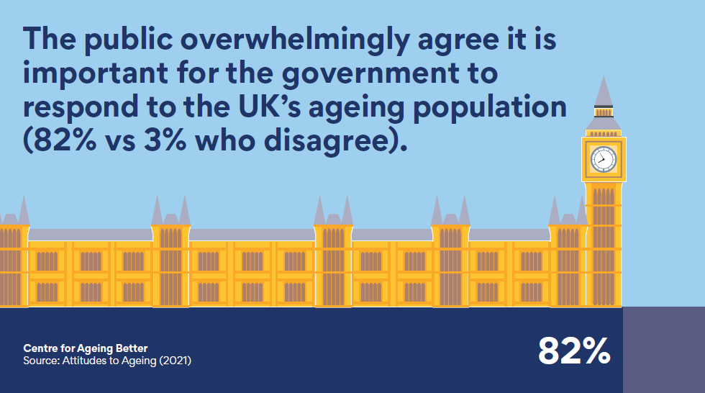

Slide 37
1. A Commissioner could help government form an ageing population strategy
2. A Commissioner would address growing ageing inequalities
3. A Commissioner would champion the rights of older people
4. A Commissioner could help redefine attitudes towards ageing
5. Ageing better benefits all of us
Notes:
Appointing a commissioner is a popular policy. Ageing is something that everyone experiences, whether directly or through their families, so improving this experience will benefit people of all ages.
England has had a Children’s Commissioner since 2004, and older people in Wales and Northern Ireland already have Older People’s Commissioners championing their needs. It is time that England had a Commissioner for Older People and Ageing too.
Rather than waiting for the consequences of an ageing society to unfold before our eyes, the government should proactively work to make ageing better. Appointing a Commissioner for Older People and Ageing will be a major step towards this and is a positive solution to a significant challenge.

Slide 38
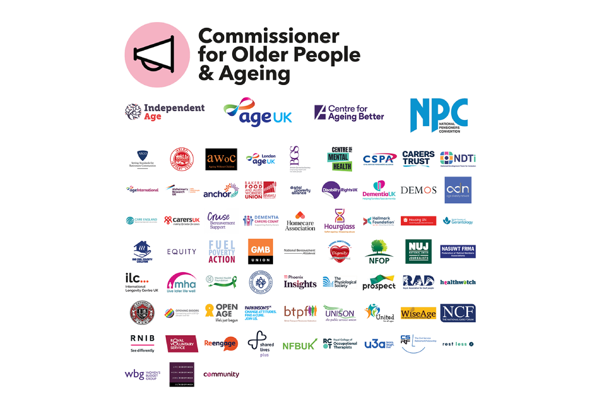

Slide 39
Questions

Slide 40
Thank you
info@ageing-better.org.uk
@Ageing_Better

