Slide 1

Black, Asian and minority ethnic older people and inequalities
Tracey Bignall
Senior Policy and Practice Officer

Slide 2
Race Equality Foundation – who we are?
Overall aim is to improve experiences and outcomes for Black, Asian and minority ethnic communities. We do this by:
Exploring evidence on discrimination
Developing evidence-based better practice
Disseminating better practice
Work with national and local partners from community, voluntary and statutory sector

Slide 3
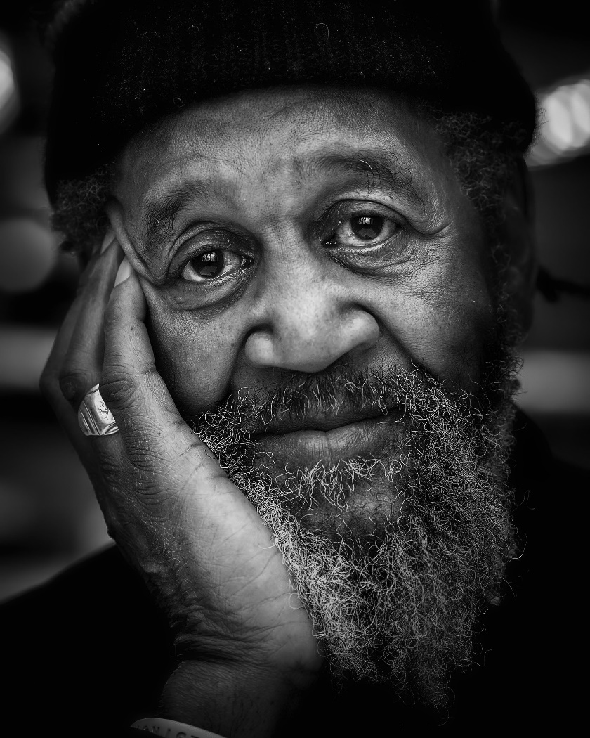
Outline
Scarce research
Intersectional issues impact on health
Inequalities in health
Action to address inequalities

Slide 4
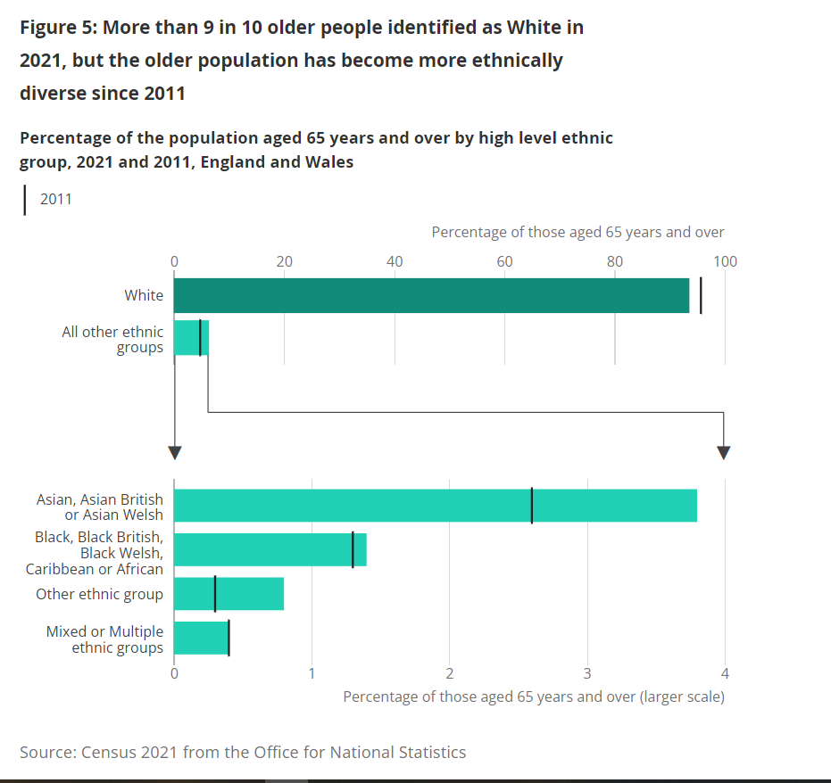
Breakdown of older people

Slide 5

Intersectional issues
Intersections between socioeconomic status, ethnicity and racism intensify inequalities in health for ethnic groups (Marmot et al, 2020).
Poorer health, health inequalities, income, housing, financial insecurity
Historical racism impacts on both mental and physical health and adds to inequalities older people face – ‘weathering effect’

Slide 6
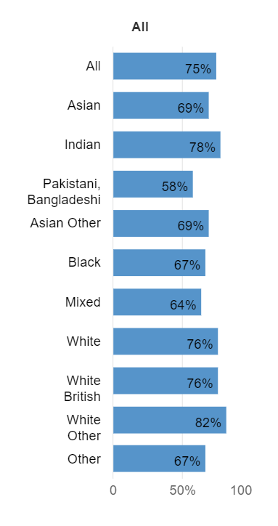
Work and no play?
Income and employment
Persistent poverty - deprivation
Minority ethnic communities tend to have lower employment rates with the lowest employment rate was in the combined Pakistani and Bangladeshi ethnic group (ONS, 2021)
More likely to be in paid work in their 50s and 60s than white groups and are less likely to have retired (Centre for Better Ageing).
Unpaid carers
People in ethnic groups with higher rates of disability and poorer health typically also provided more unpaid care (ONS, 2023)
Percentage of 16-64 year old who were employed (ONS, 2023)

Slide 7
Health conditions and ethnicity
Cardiovascular Disease (CVD)
Higher incidence, prevalence and mortality from CVD in South Asians
South Asians are at increased risk of developing Coronary heart disease
African, Caribbean and South Asians more likely to have high blood pressure
Type two diabetes
African, Caribbean and South Asians increased risk of developing type 2 diabetes, and from a younger age
Obesity
Black people have the highest percentage of overweight or obese adults out of all ethnic groups

Slide 8
Dementia research and Black, Asian and minority ethnic communities
Black and South Asian people are younger at point of dementia diagnosis, have less survival time and die at a younger age
25,000 people from Black, Asian and minority ethnic communities have dementia – this is predicted to double by 2026 – with the greatest increase expected in South Asian communities
Socioeconomic deprivation in England and Wales is associated with increased dementia mortality, younger age at death with dementia, and poorer access to specialist diagnosis
(Mukadam et al., 2022, Shiekh et al., 2020, Jitlal et al., 2021)
Disparities with reablement services.

Slide 9
Multiple long term conditions, age and inequalities
Risk of long term condition increases with age
Ethnic inequalities in Multiple Long Term Conditions emerge by middle age. Most minoritised ethnic people age 45 years and above had higher prevalence of MLTCs than people of white British ethnicity. These ethnic inequalities extended into later life as older Indian, Pakistani, Black Caribbean and people of Other ethnicity were found to be at an increased risk of MLTCs when compared to older white British people (Hayanga et al (2022)
Inequalities in health related quality of life with older ethnic minority adults associated with a decrease in life expectancy, with estimates of disability-free life expectancy being 10 years lower for Bangladeshi men and 12 years lower for Pakistani women than white British counterparts (Watkinson et al, 2023)

Slide 10
Action to address inequalities
Overall, policy changes are need to improve equity of socioeconomic opportunity and access to services for older adults from minority ethnic groups
Further research to understand the drivers of inequalities – address challenges to inclusion in research.
Better data needs to be collected e.g. recording of ethnicity (and relevance throughout the life course) and used to inform practice
Black and Asian led voluntary organisations are often at the forefront of addressing needs of Black, Asian and minority ethnic older people but need better resourcing.
More collaborative working between health and care services, voluntary sector and local authorities to create whole system change - Leeds Dementia Partnership

Slide 11
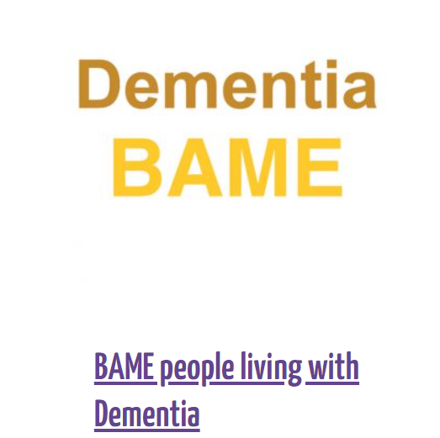
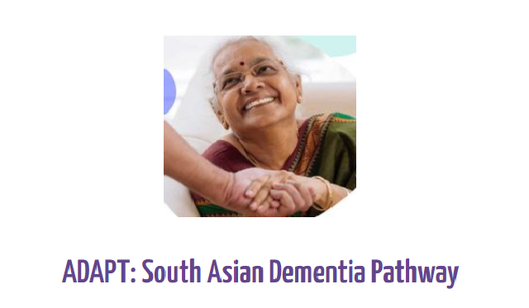
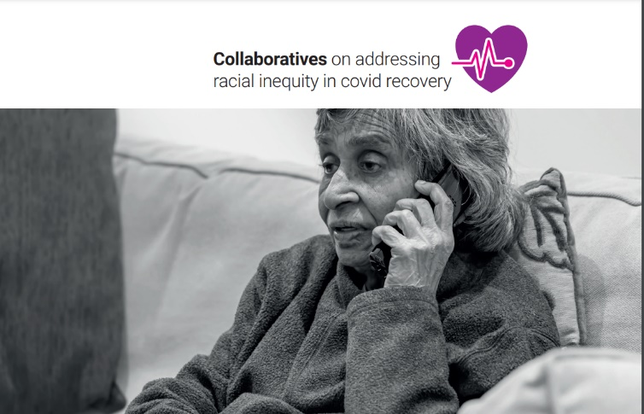
More information
Please visit our website for more information and sign up to our newsletter
www.raceequalityfoundation.org.uk
Also sign up to the Health Equals campaign at:
https://healthequals.org.uk/

