Slide 1



Disability and Ageing
Ann Leahy, PhD. Ann.Leahy@mu.ie

Slide 2
Background: Disability and Ageing
Some Empirical Findings;
Topics for Discussion

Slide 3
Background: Some Statistics (Europe)
Europe: What percentage of disabled people are aged 65+?
Aged 65+: 48% of disabled people(approx. 41.4m)
SILC survey - people living in private households – the percentage of older disabled people would be higher if nursing home residents were included.
2m+ older disabled people (65+) live in institutions (including retirement homes).
Grammenos , S. (2021) European comparative data on Europe 2020 and persons with disabilities Labour market, education, poverty and health
analysis and trends December (for the EU Commission)

Slide 4
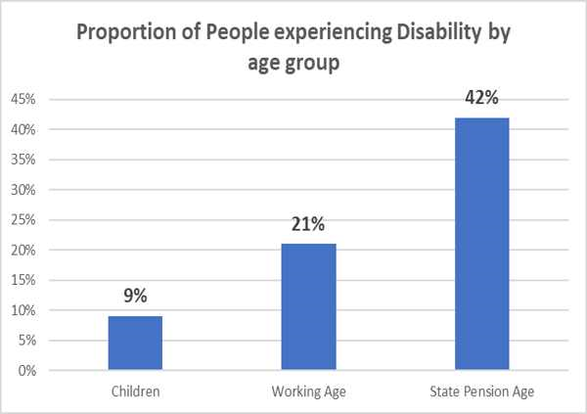
Background: Disability Prevalence Rises with Age
UK:
Adults over state pension age twice
as likely to be disabled as working
age adults (42% vs 21%).
Most people aged 80+ (59%) reported experiencing disability.
And…number of persons aged 80+ expected to triple, 2020 to 2050. WHO, Aging and Health
https://www.who.int/news-room/fact-sheets/detail/ageing-and-health
(Kirk-Wade, E. Research Briefing, UK disability statistics: Prevalence and life experiences, House of Commons Library 29 July 2022)

Slide 5
Background – Older People with Impairments not considered ‘disabled’
The majority of disabled people are over retirement age ...Despite this…older people with impairments are rarely regarded as ‘disabled’
(Priestley 2006).
It is underappreciated that older people make up a sizeable and growing proportion of disability populations – disability itself is ‘ageing’

Slide 6
Background: Disabled People are Living Longer – (AWD group)
Demographic Shift
More people are ageing with long-term disability (AWD) (Molton & Ordway 2019).
Limited knowledge about experiences of AWD
AWD group -
Challenge to Connect
AWD: challenges separate sectors to connect more (public policies; ageing and disability activism; theorising/academia)
UK: some 20% of older disabled people experienced disability prior to age 50 (DWP, 2013)
Underdeveloped policy frameworks in many countries; and sometimes fear that control and choice will diminish within services for ‘older’ people (Molton and Ordway, 2019; Carter Anand et al, 2012)
Limited research – experiences not well understood;

Slide 7
Background: Disadvantage among older Disabled People
People who age with disability (AWD group) do so with a legacy of disadvantage because disabled people in general experience:
Lower levels of education and worse employment prospects than others (UN, 2018).
More likely to live in poverty than non-disabled people (UN, 2018).
Less likely than others to have been married or to have cohabited (Loprest and Maag, 2007 ; MacDonald et al, 2018 ), so may have fewer supportive intimates in older age.

Slide 8
What is Disability: Conceptualisation/Models/
Older Age
‘Disability’ in older age – Medical Model dominates:
Usually seen as inability to perform certain actions (typically, ADLs or IADLs);
OR
‘Frailty’ – usually defined in narrow physical or medical terms (Grenier, 2012).
‘Disability’ generally, Social Model understandings involve:
Distinction between impairment (in the body) and disability (in society);
Implies dismantling social and physical barriers to participation.
Notes:
ADLS: basic activities such as mobility and self-care
IADLS: (preparing meals, shopping, taking medication) performed to live independently

Slide 9

What is Disability: UNCRPD
The Convention on the Rights of Persons
with Disabilities (CRPD):
Disability is interactional – understood as the outcome of impairments in interaction with environments (emphasises attitudinal and environmental barriers);
Definition is broad enough to include disability experienced at any age.
BUT
  NOT widely applied to older people experiencing impairment or with long-term care needs.

Slide 10

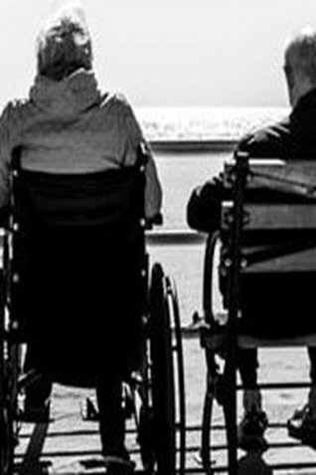
What is Disability: UN CRPD – not applied in
older age
Older people: not perceived as people
with rights but as mere beneficiaries of
care and welfare…. human rights violations committed against older disabled people are often neither monitored nor categorised as such.
Catalina Devandas-Aguilar, Report of the Special Rapporteur on the rights of persons with disabilities. Distr.: General 17 July 2019 Seventy-fourth session A/74/186.
AGE Platform Europe - a majority of its members not involved in the implementation/ monitoring of the CRPD in their country; some not even aware of its existence.
AGE Platform Europe Position on Article 19 of the UNCRPD. https://www.age-platform.eu/sites/default/files/AGE_input_CRPD_Art19.pdf

Slide 11
Some Empirical Findings and Topics for Discussion

Slide 12
Ageing with Disability (AwD) people who have lived with lifelong or early/adult-onset, now ageing
Disability with Ageing (DwA) –
or ageing into disability– people who experience disability as they age (after mid-life)
….Every human being is either ageing into disability or ageing with disability (Bickenbach, 2021)
My Study: 42 older people; Physical and sensory disability

Slide 13

Empirical Findings:
Disablement Processes and Responses to them
My study suggests that ‘disability’ in older age was not just a bodily or ‘medical’ experience:
As well as Bodies…….people could experience more or less disability depending on the following factors:
Social/familial factors.
Support/care, Therapies, Appliances.
Home, External Environments, transport.
Relational issues: Everyday Interactions with others (Leahy, 2021)

Slide 14
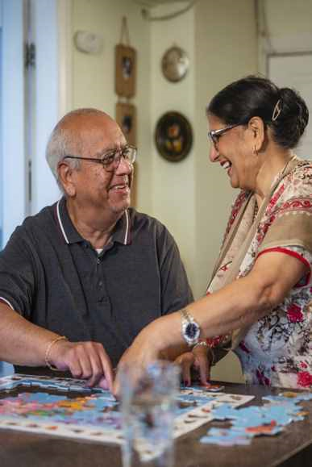
Empirical Findings: Disabling or Enabling Contexts
Social/ familial factors
Both groups understood how they functioned as part of a relational or social unit, particularly with a spouse if they had one. Loss of intimates bound up with experiences of disability in older age.
AwD group less likely to have married or cohabited (see MacDonald et al, 2018)
Image:
Centre for Ageing Better

Slide 15
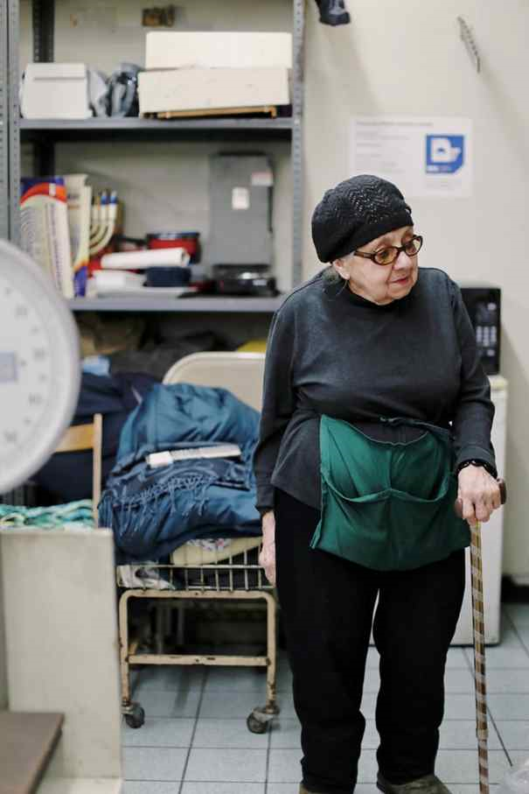
Empirical Findings: Disabling or Enabling Contexts
Support and care
Having access to financial resources or, alternatively, supportive public provision facilitated functioning and participation, and reduced perceptions of disability.
Poverty – Associated with disability (AWD group)
Sometimes- AwD group benefitted from staying within ‘disability’ services

Slide 16
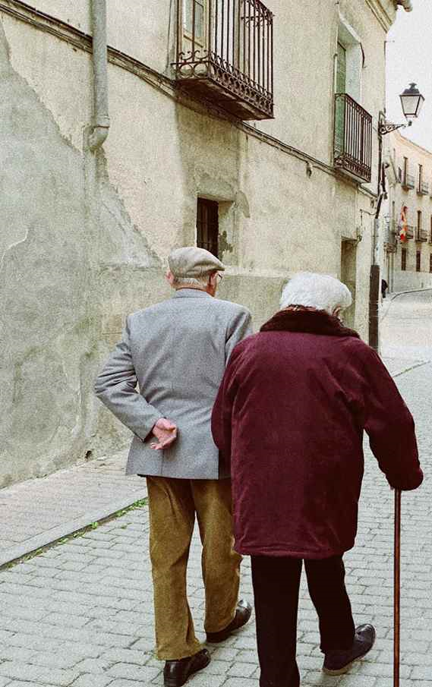
Empirical Findings: Disabling or Enabling Contexts
Physical environments
If home/communities were accessible - perceived less ‘disability’ as a result.
Disabling environments (like undipped footpaths, inaccessible transport) were disabling of both groups

Slide 17
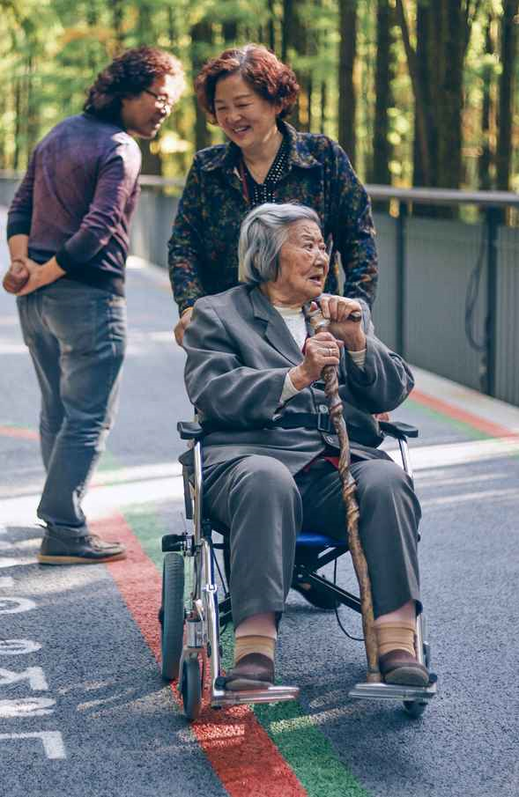
Empirical Findings: Disabling or Enabling Contexts
Sociocultural meanings in everyday interactions:
DwA group could be othered even within families and community groups
AwD group invalidating and discrediting processes had shaped their experience in the long term.
Disablism……..

Slide 18
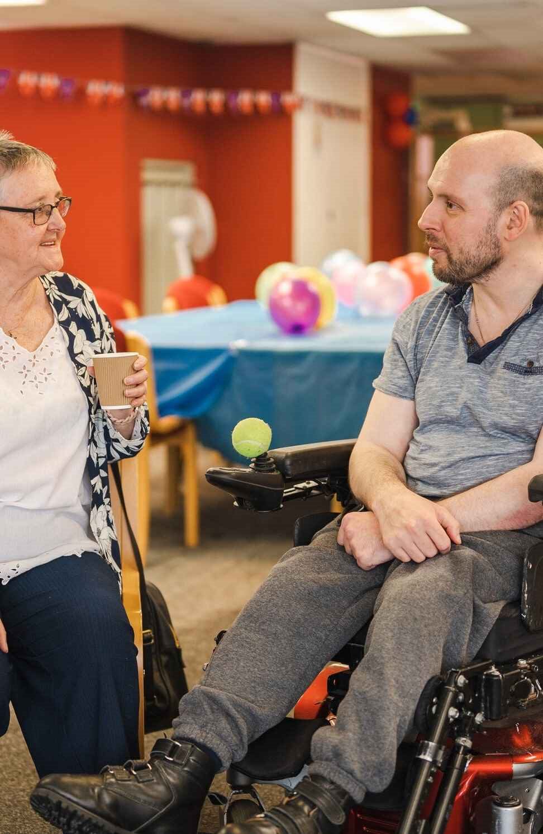
Empirical Findings: Disabling or Enabling Contexts
Sociocultural meanings in everyday interactions:
DwA group
“There are times that I certainly feel disabled, like when you can't go on the bus when there is a group going to a shopping centre…. It is not a problem with the bus, it is only a problem with the organisers. They think I am disabled. ……It is not said in so many words but there is no other reason why I can't go”. Carmel (DwA)
Image:
Centre for Ageing Better

Slide 19
Empirical Findings: Disabling or Enabling Contexts
AwD Group
Sociocultural meanings in everyday interactions:
People have an awful habit of talking over your head, ….. it's like… if they touch you or speak to you that they are going to catch it …..I really don't know but I find people today really haven't changed much
Janice (AwD)
Other (AwD group) felt that ageing meant they stood out less or lives resembled their age peers more.

Slide 20
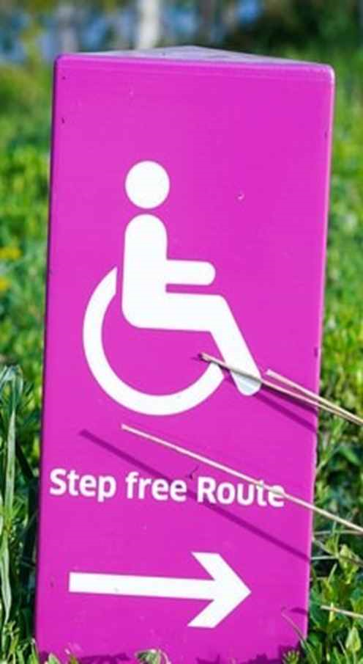
Comparable Experiences?
So for AwD group
Experiences of impairment/disability/ social exclusion across the lifespan could have significant negative consequences (e.g. ageing brings additional impairments with limited income/few savings, limited social support)
External barriers - had detrimentally shaped lives for longer
Means: We need a particular focus on AwD group or on anyone experiencing disability over the long term.

Slide 21
Some Conclusions/ Future Directions
Older disabled people (maybe especially people ageing with long-term disability) may be able to contribute a more holistic appreciation of what it means to live a fulfilling life with disability in older age – unrecognised as a resource to inform policy-making.

Slide 22
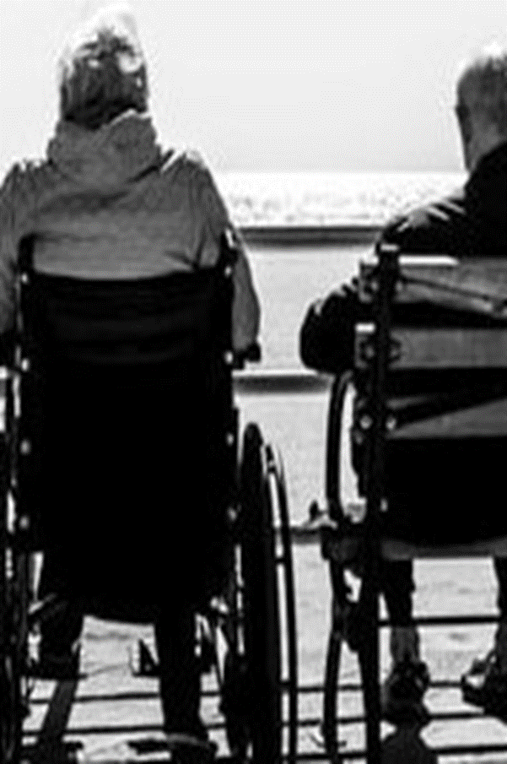
Some Conclusions/ Future Directions
UN Convention on the Rights of Persons with Disabilities
‘older persons with disabilities frequently fall through the cracks’ former Special Rapporteur on the rights of persons with disabilities (Devandas-Aguilar 2019)
Interactional concept of disability in the Convention accords with the experience of disability in older age which is not just a physical/medical phenomenon (Leahy, 2021)
………activism on dementia increasingly invokes the Convention

Slide 23
Some Conclusions/ Future Directions
If more widely understood/adopted, an interactional or human rights model of disability (as per the Convention) could:
Encompass older disabled people within the category of ‘disabled’ people;
Provide a common language between separate sectors.
….Every human being is either ageing into disability or ageing with disability (Bickenbach, 2021)

Slide 24
References
Barnes , C. and Mercer , G. (2010 ) Exploring Disability , 2nd edn, Cambridge: Polity Press.
Bickenbach, J. (2021). ‘Segmenting Ageing and Disability Policy Ethical Concerns’ In M.Putnam and C.Bigby, Routledge Handbook on aging with disability.
Bishop , K. and Hobson , S.J.G. ( 2015 ) ‘Perceptions of aging for persons with adult- onset disability’, Journal of Canadian Gerontological Nursing Association , 37(4): 6– 19.
Carter Anand , J. , Davidson , G. , Macdonald , G. , Kelly , B. , Clift-Matthews , V. , Martin , A. and Rizzo , M. ( 2012 ) The Transition to Personal Budgets for People with Disabilities: A Review of Practice in Specified Jurisdictions , Dublin: National Disability Authority.
Coyle , C.E. and Mutchler , J.E. ( 2017 ) ‘Aging with disability: advancement of a cross- disciplinary research network’, Research on Aging, 39(6): 683– 92.
Degener, T. (2017). A New Human Rights Model of Disability. In V. Della Fina, R. Cera, & G. Palmisano (Eds.), The United Nations Convention on the Rights of Persons with Disabilities: A Commentary (pp. 41-60). Cham: Springer
Devandas-Aguilar, Report of the Special Rapporteur on the rights of persons with disabilities. Distr.: General 17 July 2019 Seventy-fourth session A/74/186.
DWP (Department of Work and Pensions). 2013. Fulfilling Potential: Building a Deeper Understanding of Disability in the UK Today
Estes, C, Biggs, S Phillipson, C. (2003) Social Theory, Social Policy and Ageing: A Critical Introduction. Buckingham: Open University Press.
Garland- Thomson , R. ( 2016 ) ‘Becoming disabled: roughly one in five Americans lives with a disability. So where is our pride movement?’, New York Times . Available at: www.nytimes.com/ 2016/ 08/ 21/opinion/ sunday/ becoming- disabled.html
Grenier , A. ( 2012 ) Transitions and the Lifecourse: Challenging the Constructions of ‘Growing Old’ , Bristol: Policy Press.
Jönson , H. and Larsson , A.T. ( 2009 ) ‘The exclusion of older people in disability activism and policies – a case of inadvertent ageism?’, Journal of Aging Studies , 23(1): 69– 77.

Slide 25
References
Kelley- Moore , J.A. ( 2010 ) ‘Disability and ageing: the social construction of causality’, in Dannefer, D. and Phillipson, C. (eds) The Sage Handbook of Social Gerontology , London: Sage, pp 96– 110.
Laslett , P. ( 1996 [1989] ) A Fresh Map of Life: The Emergence of the Third Age , 2nd edn, Basingstoke: Palgrave Macmillan.
Leahy , A. ( 2018 ) ‘Too many “false dichotomies”? Investigating the division between ageing and disability in social care services in Ireland: a study with statutory and non- statutory organisations’, Journal of Aging Studies , 44: 34– 44.
Leahy, A. Disability and Ageing: Towards a Critical Perspective, 2021, Bristol: Policy Press
Molton , I.R. and Ordway , A. ( 2019 ) ‘Aging with disability: populations, programs, and the new paradigm: an introduction to the special issue’, Journal of Aging and Health , 31(IOS): 3S– 20S.
Monahan, D. and Wolf , D. (2014 ) ‘The continuum of disability over the lifespan: the convergence of aging with disability and aging into disability’, Disability &Health Journal , 7(1 – Supplement): S1– 3.
OECD/European Union (2020), Health at a Glance: Europe 2020: State of Health in the EU Cycle, OECD Publishing, Paris
Oliver, M. ( 1990 ) The Politics of Disablement , Basingstoke: Macmillan.
Pack , R. , Hand , C. , Laliberte Rudman , D. and Huot , S. ( 2019 ) ‘Governing the ageing body: explicating the negotiation of “positive” ageing in daily life’, Ageing & Society , 39: 2086– 108.
Pike , B. , O’Nolan , G. and Farragher , L. ( 2016 ) Individualised Budgeting for Social Care Services for People with a Disability: International Approaches and Evidence on Financial Sustainability , Dublin: Health Research Board.
Putnam , M. ( 2014 ) ‘Bridging network divides: building capacity to support aging with disability populations through research’, Disability and Health Journal , 7(1): S51– 9.
Thomas , C. ( 2004 ) ‘How is disability understood? An examination of sociological approaches’, Disability & Society , 19(6): 569– 83.
UN (2018). Promoting Inclusion through Social Protection Report on the World Social Situation 2018. United Nations
New York, 2018
Watson , N. ( 2003 ) ‘Daily denials: the routinisation of oppression and resistance’, in Riddell , S. and Watson , N. (eds) Disability, Culture and Identity , Harlow: Pearson Education, pp 34– 51.

