Slide 1
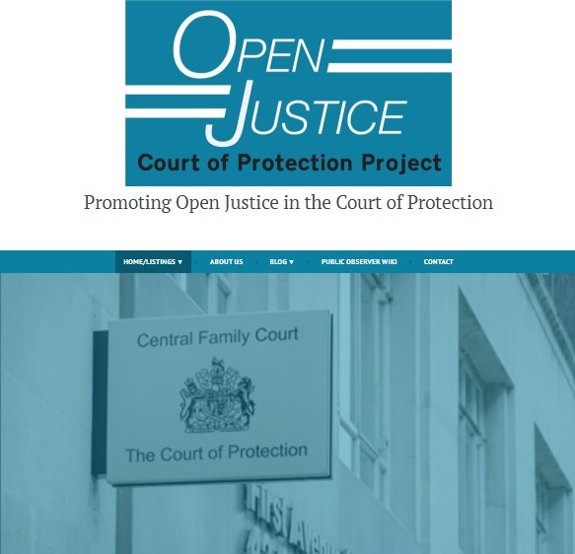

OLDER PEOPLE AND MENTAL CAPACITY: THE IMPORTANCE OF OPEN JUSTICE IN THE COURT OF PROTECTION
THE OPEN JUSTICE COURT OF PROTECTION PROJECT
Gillian loomes-Quinn
Human Rights of older people networking conference
28th April 2023

Slide 2


Older People in the Court of Protection
Older people are the largest single demographic group among ‘Protected Parties’ in the CoP.
Experiences we might all anticipate – e.g., ADRT/LPA
(‘A Dispute about the Validity of Lasting Power of Attorney’)
Court proceedings centre ‘P’s’ views and ‘everyday’ concerns
(‘Dementia, Cats, and Football’)
Court holds professionals to account to uphold ‘P’s’ rights
(Conflating Capacity and Best Interests? Cross-Examining a Neuropsychiatrist)
Court proceedings and giving ‘voice’
(Deprived of her Liberty – My Experience of the Court Procedure for my Mum)
Notes:
Returning to the Court of Protection – obviously the Court has a history of concern with ‘transparency’ and with balancing competing interests of Open Justice with the right to privacy of those with whose lives it becomes involved. But the move the ‘remote hearings’ in March 2020 at the start of the first national lockdown in England and Wales triggered a need to revisit this issue.
A multi-disciplinary thinktank – the Hive Group – was established by the Vice President of the Court, Mr Justice Hayden, to address the impact of the pandemic on litigants in the Court of Protection. And as to ‘transparency’, he issued guidance reiterating that “Transparency is central to the philosophy of the Court of Protection” and must not “…become a casualty of [the] public health emergency…”

Slide 3
Transparency & Open Justice
“…Open justice lets in the light and allows the public to scrutinise the workings of the law, for better or for worse.” Lord Justice Toulson R (Guardian News and Media Ltd) v City of Westminster Magistrates’ Court [2012] QB 618
"Publicity is the very soul of justice. It is the keenest spur to exertion and the surest of all guards against improbity. It keeps the judge himself while trying under trial.” Jeremy Bentham quoted by Lord Shaw of Dunfermline in Scott v Scott [1913] AC 417, 477
“Amongst minorities, exclusion from the social and representational order is a forceful form of symbolic violence. Persons with disabilities are systematically subjected to this sort of exclusion. In the public domain, persons with disabilities are either not represented at all, or misrepresented.” Schwarz et al. (2018) Symbolic Violence and the Invisibility of Disability
Notes:
So we’ve seen that the Court of Protection clearly has a profound impact on the lives of thousands of disabled people, but why does Open Justice matter in this Court? And how can public access to the Court benefit disabled people? In the next two slides, I consider why Open Justice is important, firstly as a general principle, and secondly from a disability rights perspective.
So, firstly the principle of Open Justice and its significance have been spelled out in case law [read quotes]

Slide 4
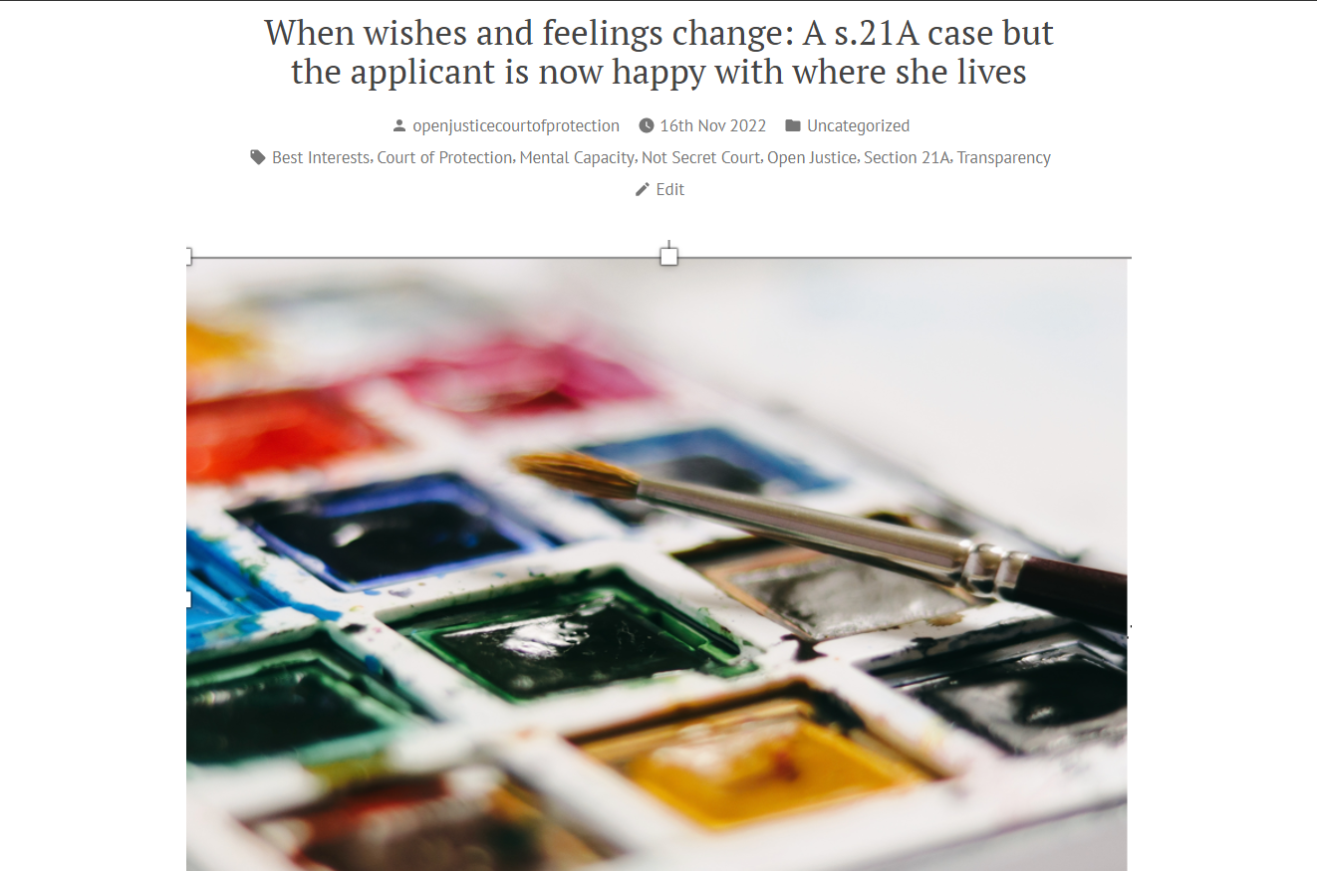
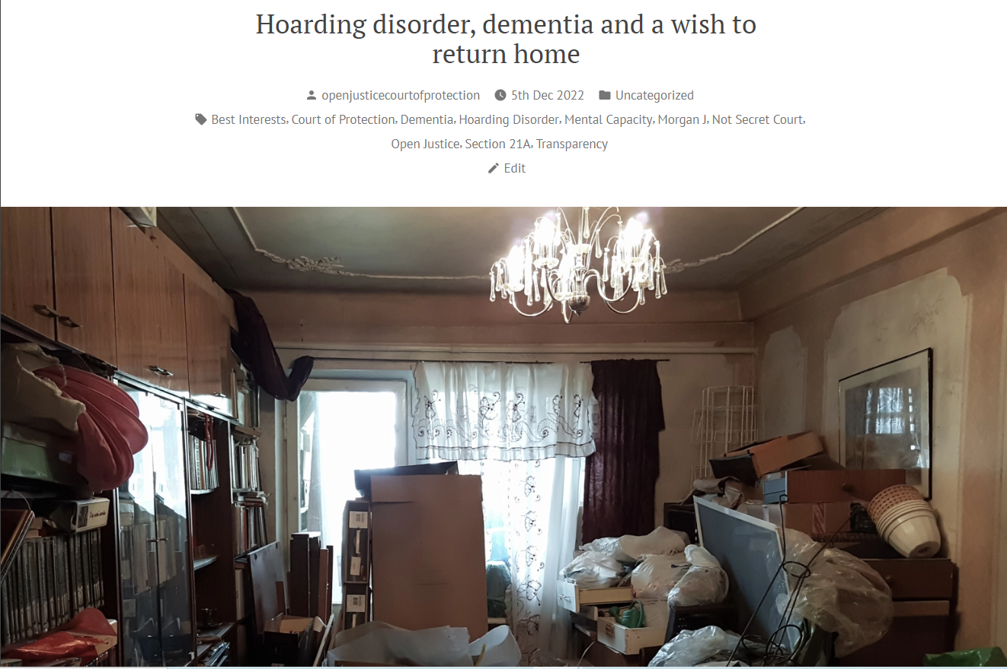
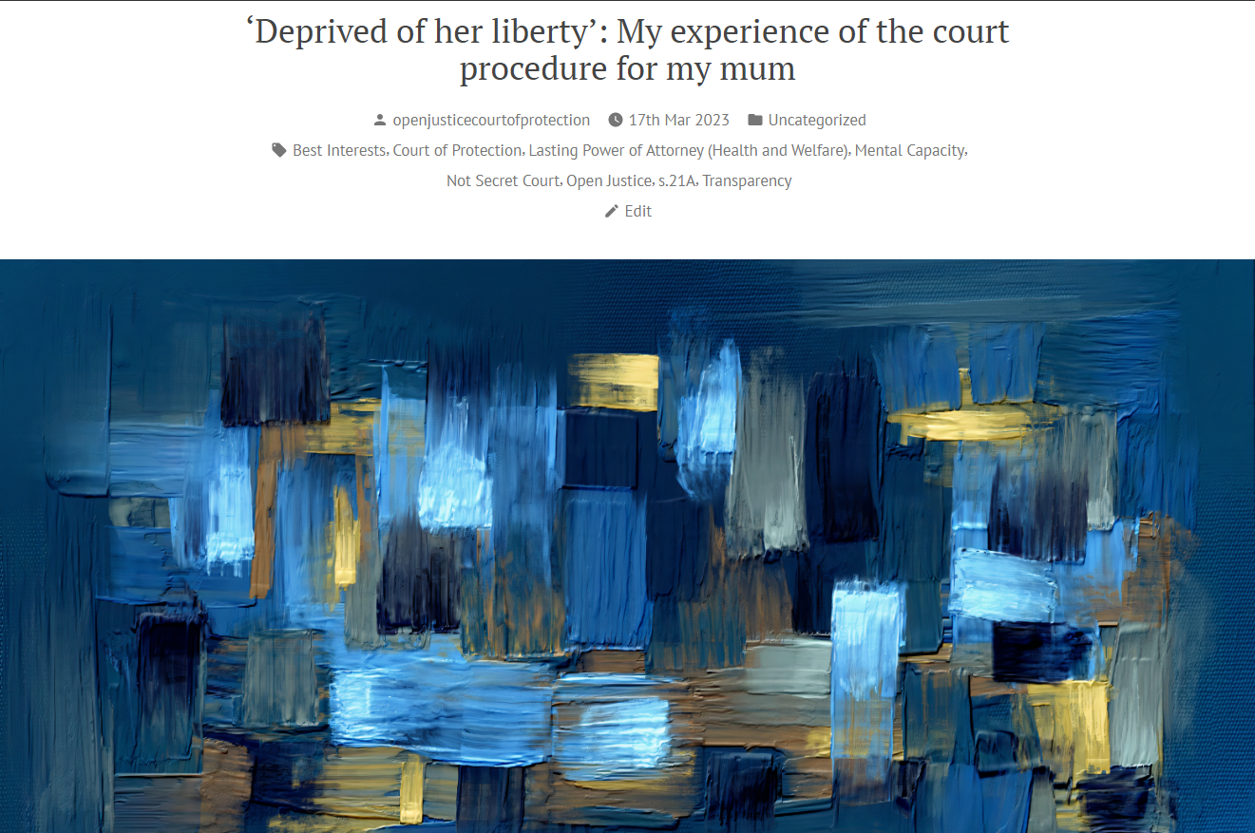
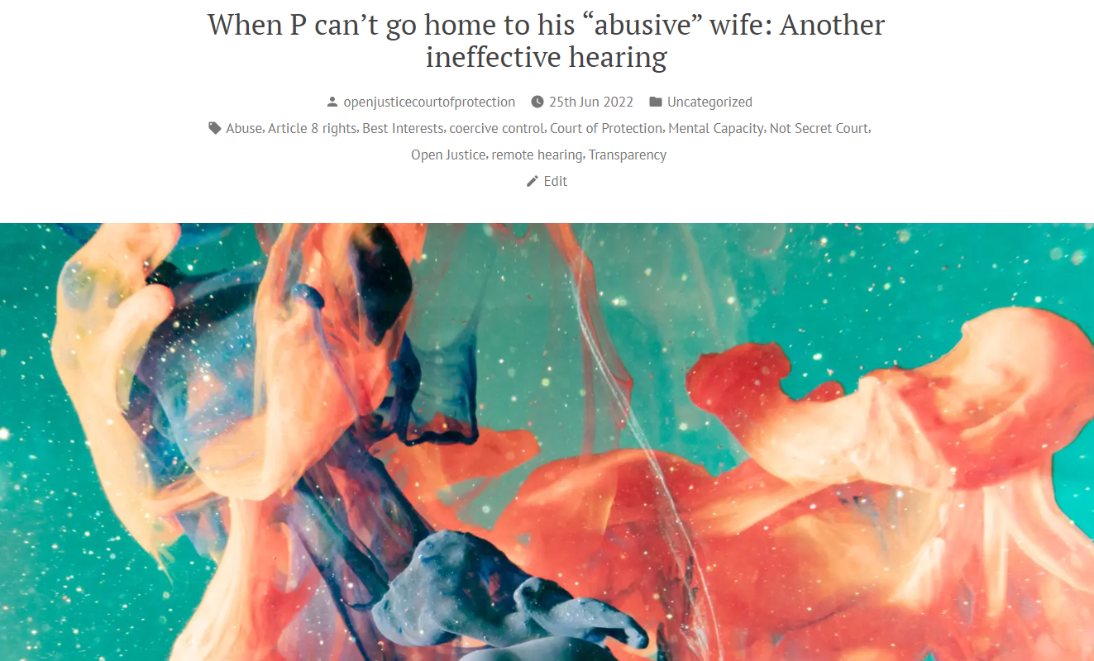
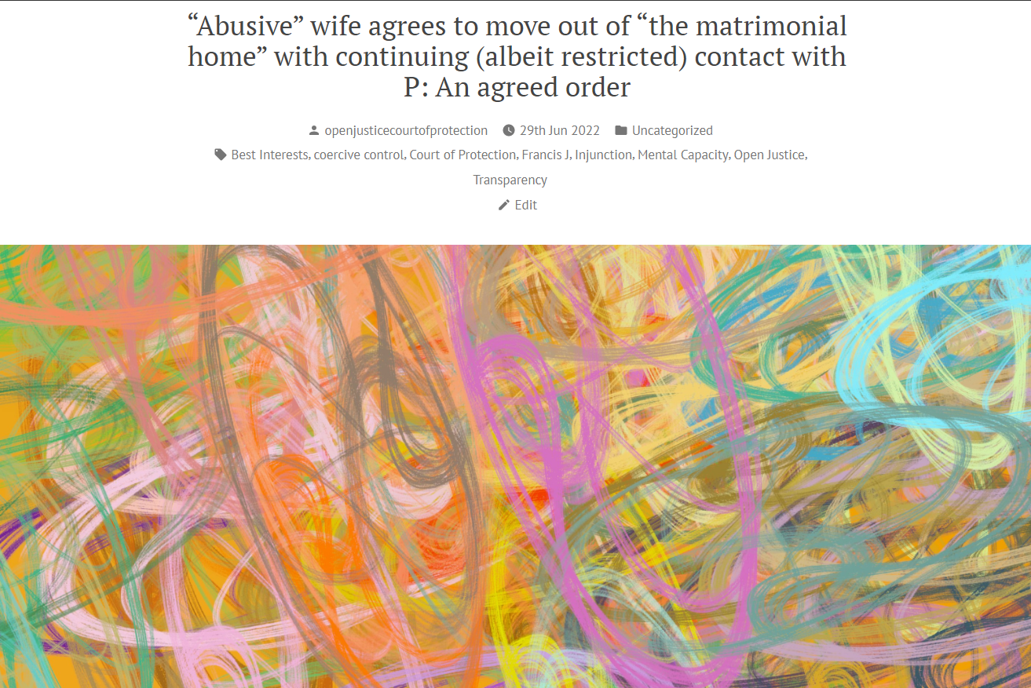


1. Read and Subscribe to our Blog
Over 350 blog posts
Around 3 posts per week
Subscribe via ‘subscribe’ box at the bottom of each page.
Search for key terms (e.g., ‘dementia’) via ‘search’ box at bottom of each page.

Slide 5
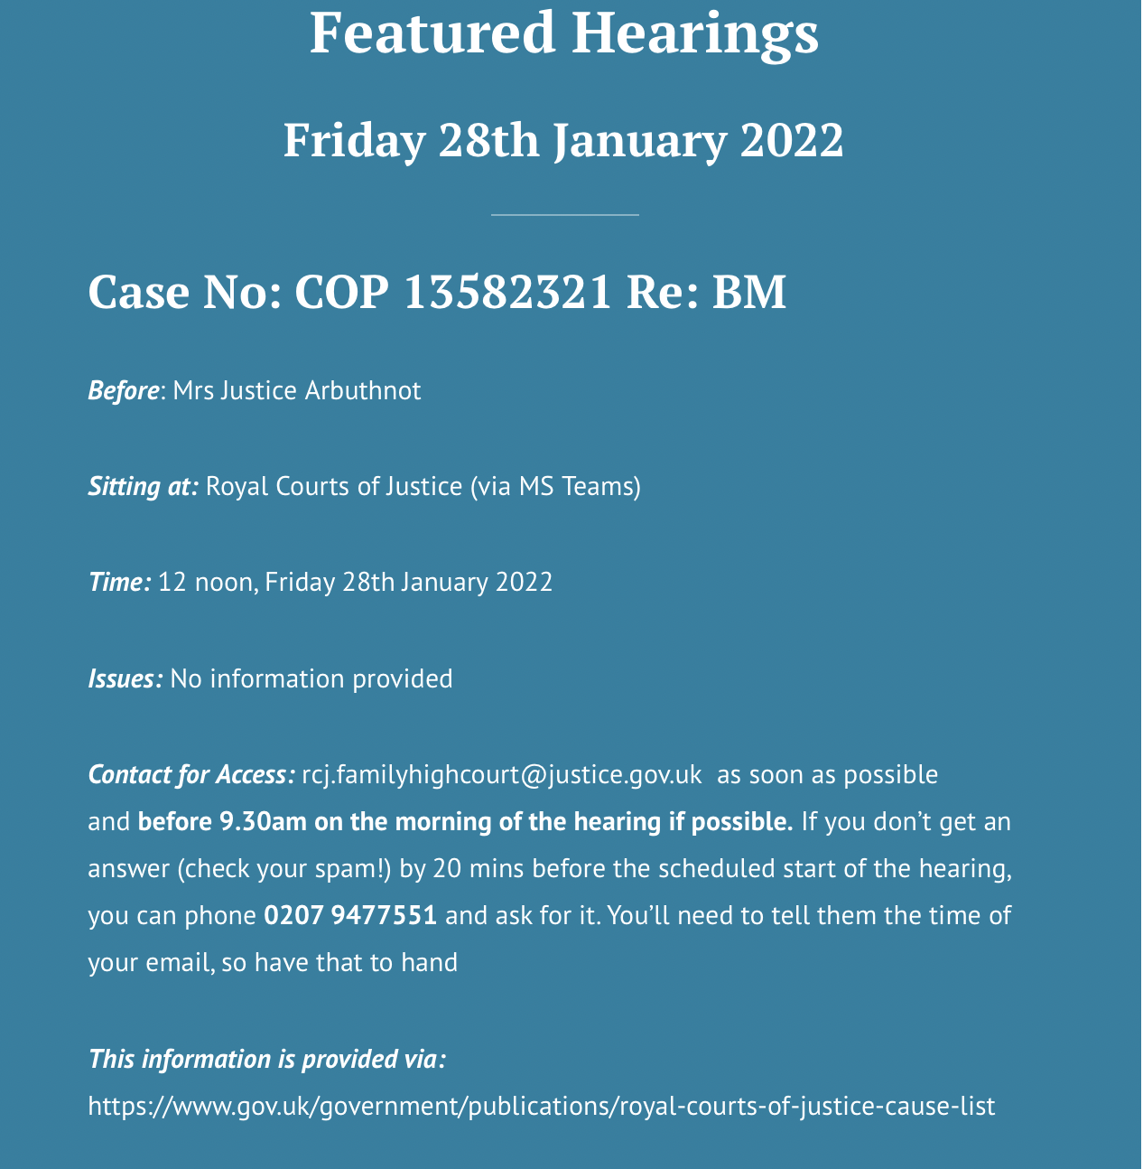

2. Observe a Hearing (and maybe write a blog?)
openjusticecourtofprotection.org
Featured Hearings
Selection of most accessible hearings each day
Probably best ‘first step’ for anyone interested in observing CoP in action
@OpenJusticeCoP
More hearings (including regional)
Ad hoc updates
Notes:
As the specialist court with responsibility for issues relating to people who lack the capacity to make specific decisions, the Court of Protection is a key location of legal and political impact for disabled people. In terms of bare numbers, we can see here that the numbers of applications made to the court each year were in the tens of thousands – with 32,029 applications being made in 2018 and 34,445 in 2019. In the most recent quarterly breakdown, we find that between June and September 2020 8937 applications were made to the court. This compares with 9407 in the same quarter of 2019 and 7900 in the same quarter of 2018, so the numbers seem relatively steady despite the impact of the Pandemic.

Slide 6

Further Details and Contact
Website:
openjusticecourtofprotection.org
The OJCOP Team
Celia Kitzinger
Co-Director
Gill Loomes-Quinn
Co-Director
Kirsty Stuart
Core Team Member
Claire Martin
Core Team Member
Twitter:
@OpenJusticeCoP
Email:
OpenJustice@yahoo.com
Notes:
Thank you so much for listening, and I now look forward to answering any questions you might have.

